Slide 1
In-depth Spectrum analysis
August 2024
Andrea Corrado

Slide 2
Outline
Correction of previous declarations about data
Why delve into spectral analysis
Expectations on EG spectrum
Processing pipeline to estimate spectrum
Filtering strategy
Spectrum estimation strategy
Results on external data
Conclusions

Slide 3
Outline
Correction of previous declarations about data
Why delve into spectral analysis
Expectations on EG spectrum
Processing pipeline to estimate spectrum
Filtering strategy
Spectrum estimation strategy
Results on external data
Conclusions

Slide 4
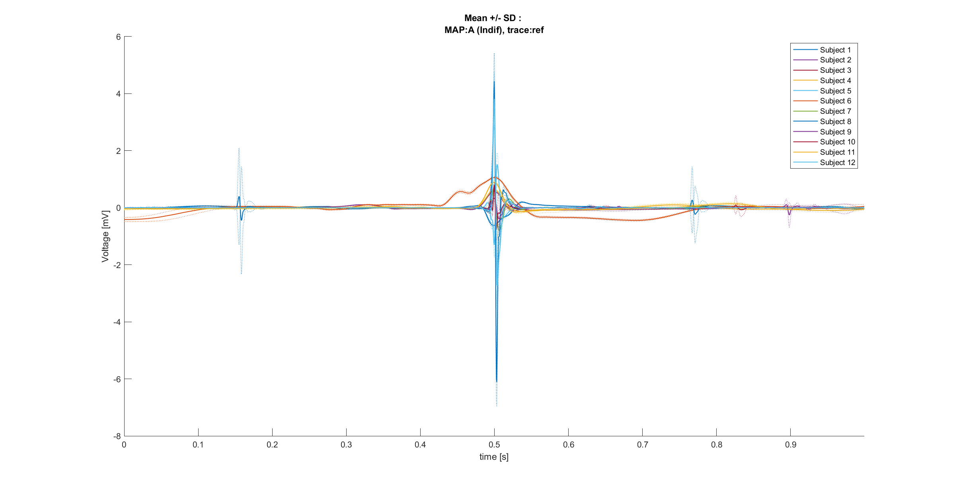
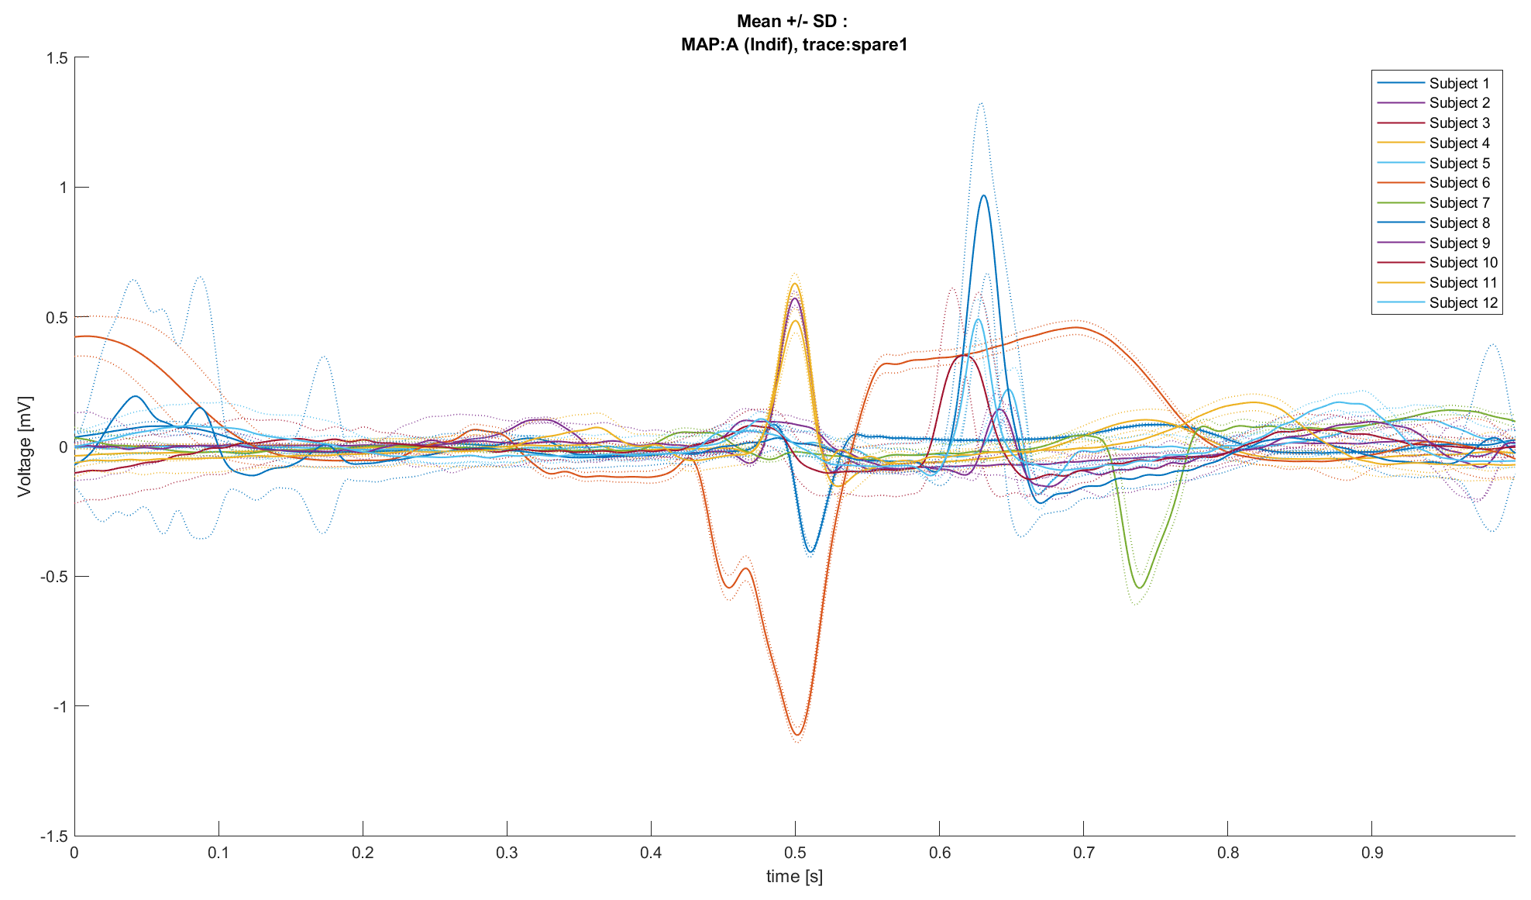
Spare1 trace ≠ Reference trace
So far, we trusted that the reference trace and the spare1 trace were composed by the same signals. But:
Reference
Spare1
Mean ± SD plots (same Map, different subjects)
Into each MAP, reference and spare1 trace aren’t the same, except for subjects 2 and 4.
Such observation support the option that spare traces have a different nature from reference ones (i.e., unipolar derivations?)
Knowing the true nature of these signals now becomes crucial.

Slide 5
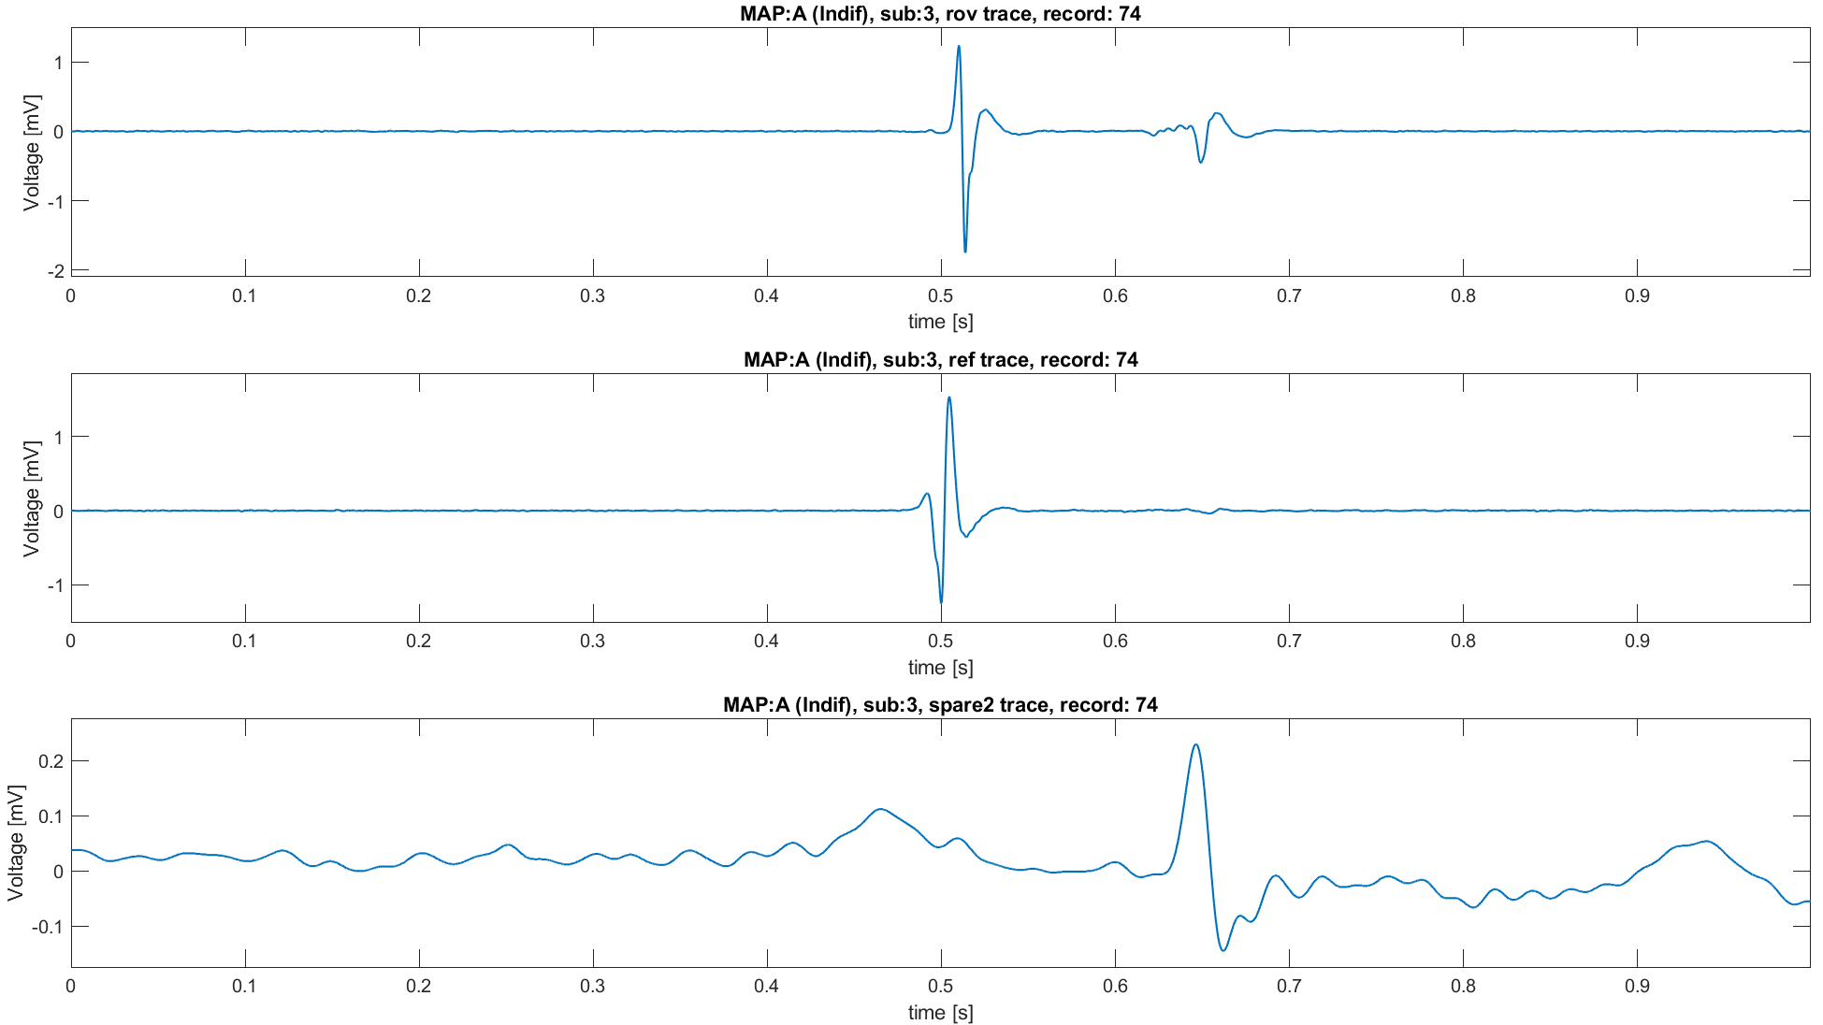
Spare1 trace ≠ Reference trace
Moreover, reference trace signals, in some cases, presents some strange behaviors:
Whole P-QRS-T cycle squeezed in a window shorter than 0.2 seconds
Such behavior suggest am heart rate higher than 60 bpm, but during the 1-second acquisition there is only a single beat
These traces present a sort of unclear oscillation temporally located where spare traces suggest the presence of a QRS.
There is often a single beat and in general centered on 0.5 seconds
It’s fundamental knowing the whole process of Reference acquisition to better contextualize these behaviors.

Slide 6
Outline
Correction of previous declarations about data
Why delve into spectral analysis
Expectations on EG spectrum
Processing pipeline to estimate spectrum
Filtering strategy
Spectrum estimation strategy
Results on external data
Conclusions

Slide 7
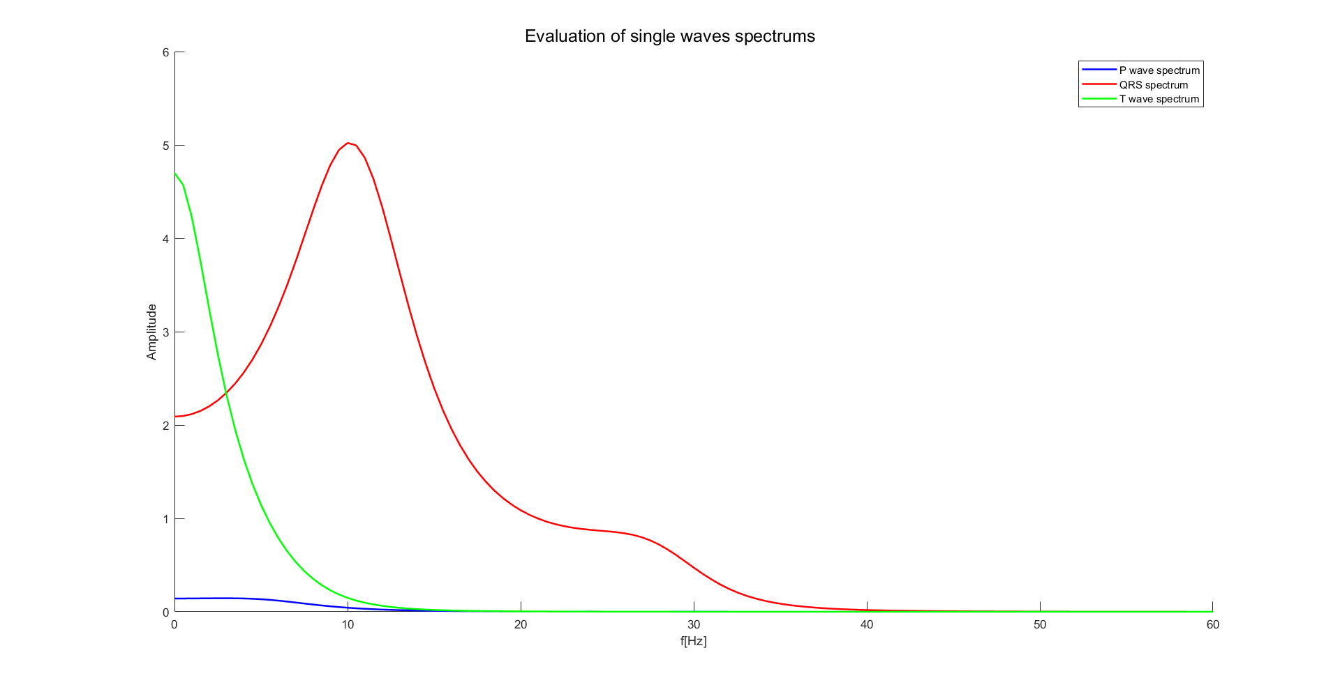
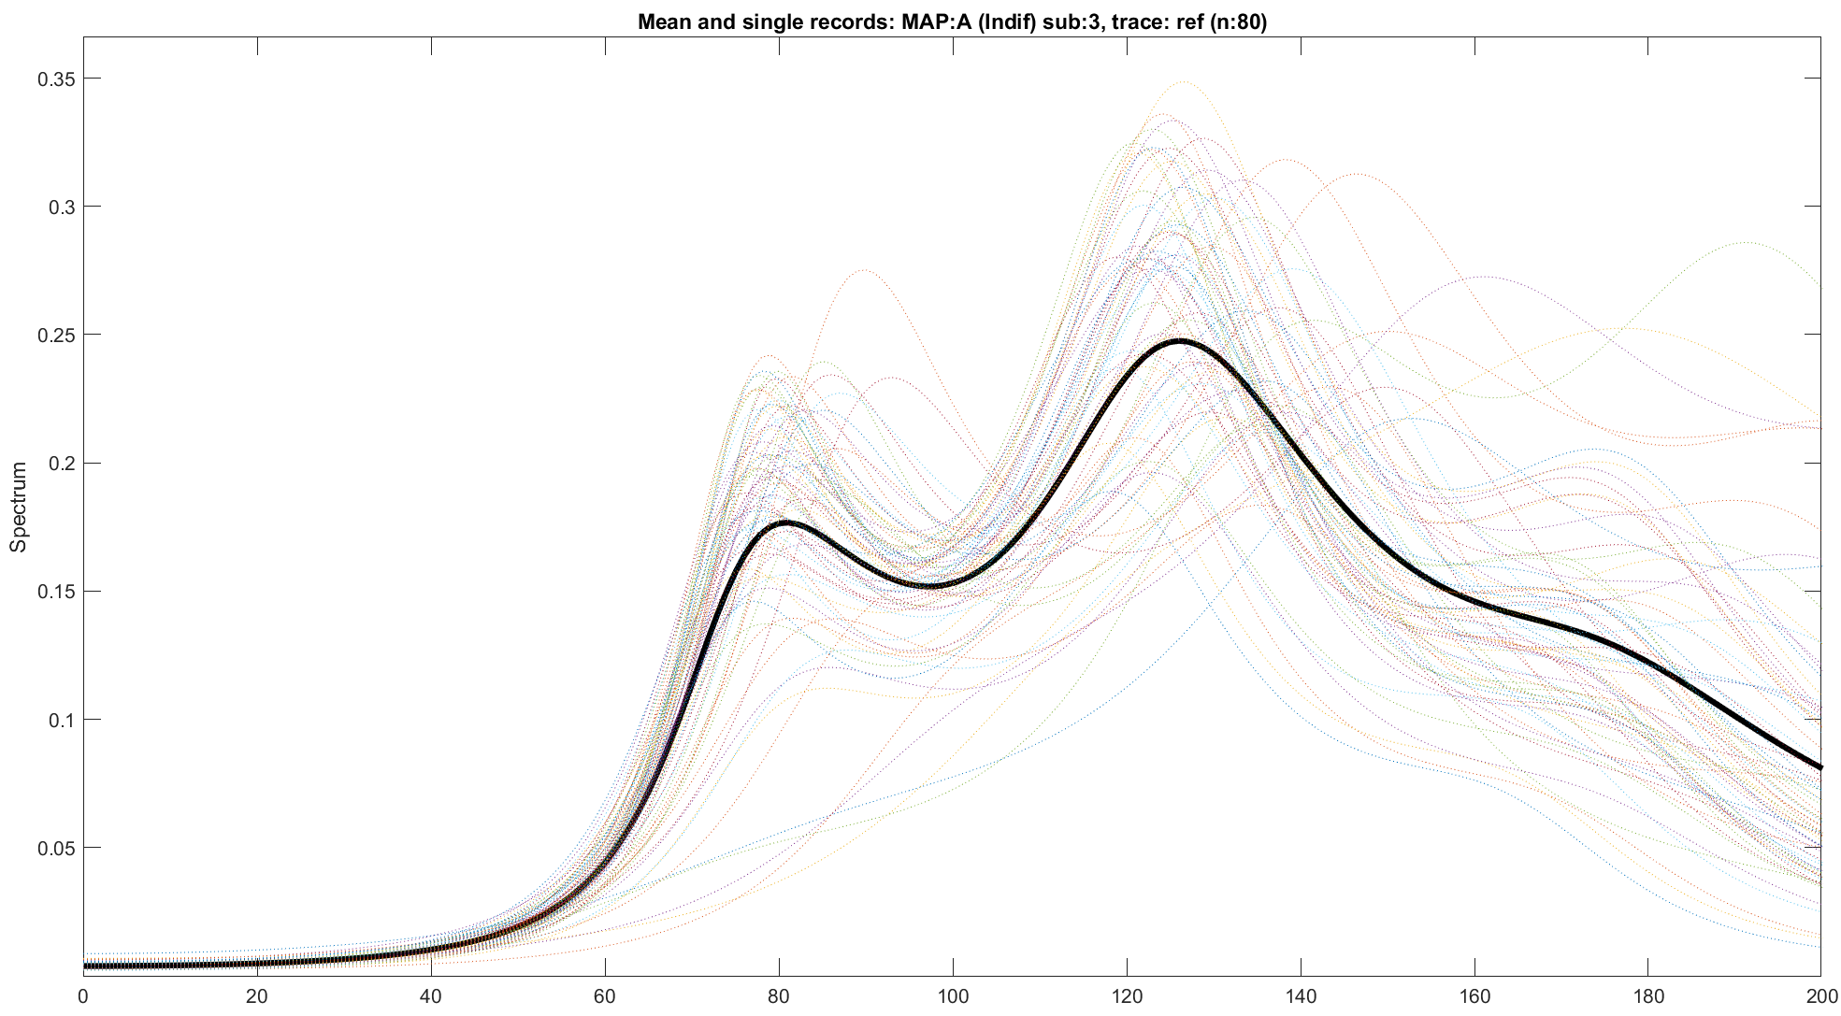
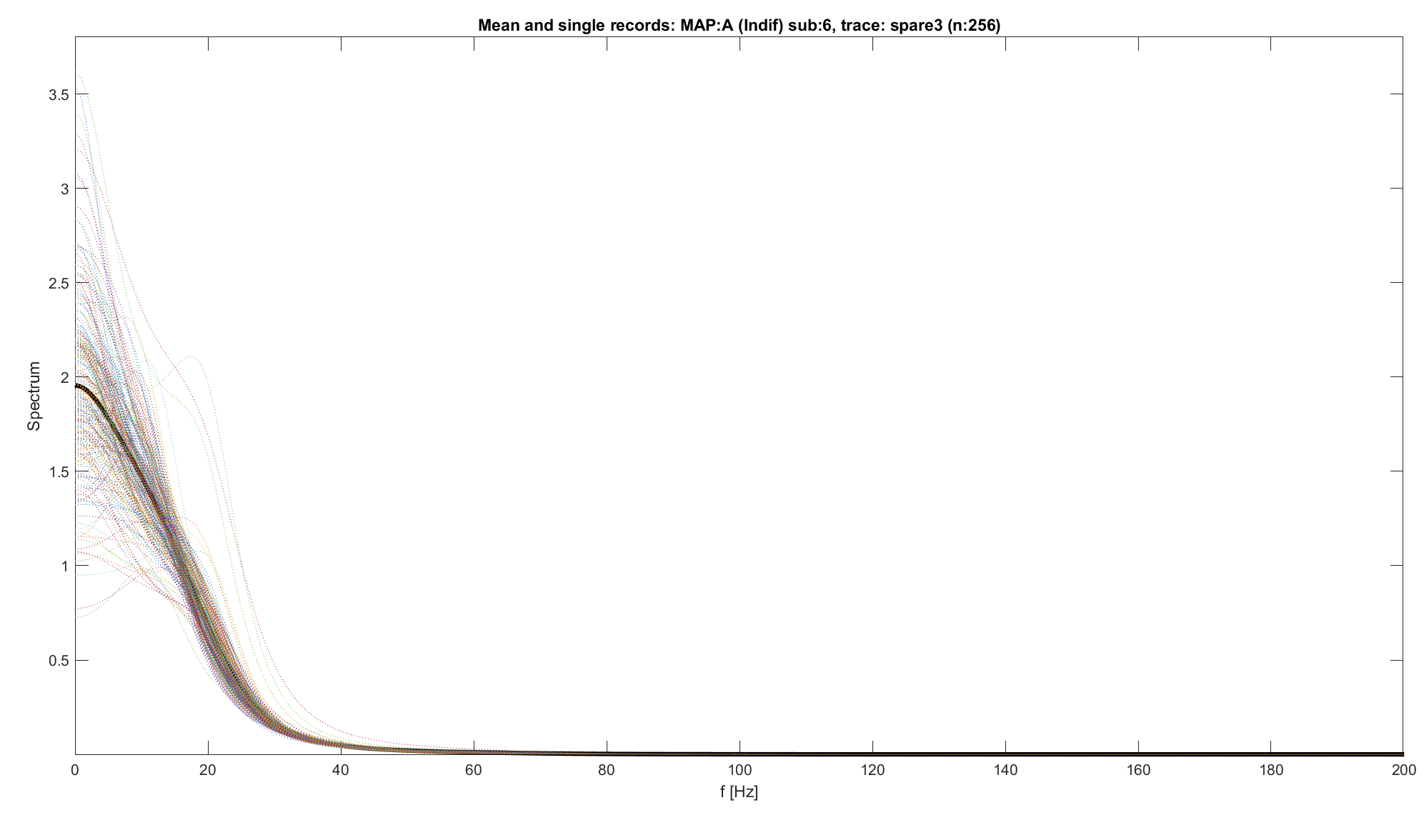
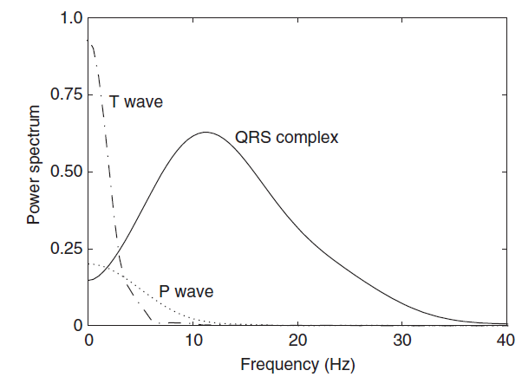
Why delve into spectral analysis
Previously, we found reference traces with unclear behaviours:
Absence of low-frequency components
Huge presence of high frequency components
Or:
Frequency components totally squeezed into low frequences, without any peak
Are these characteristics acceptable? Which is the expected shape of a spectrum of an ECG signal? [1]
T wave localised before 10H, Highest peak
P wave localized before 15 Hz, possibly masked by other components
QRS between 1 and 40 Hz, with one or more peaks.
NB: even using AR spectrum estimation the reference figure is acceptable.
Spectrums evaluated so far are not acceptable
NB: Reference figure obtained using Welch Spectrum Estimation
Sörnmo, Leif, and Pablo Laguna. "Electrocardiogram (ECG) signal processing." (2006).

Slide 8
Outline
Correction of previous declarations about data
Why delve into spectral analysis
Expectations on EG spectrum
Processing pipeline to estimate spectrum
Filtering strategy
Spectrum estimation strategy
Results on external data
Conclusions

Slide 9
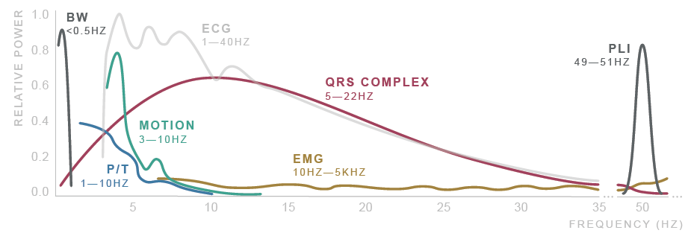
Processing pipeline
So far, data are taken as they are, without any type of preprocessing
Is known that ECG requires preprocessing because affected from various sources of noise [2]
Physiological, Environmental, Artifacts and Electronic
There are many strategies used to clean ECG signals: [2]
Numerical Filters
Averaging
Wavelet filtering
…

Slide 10
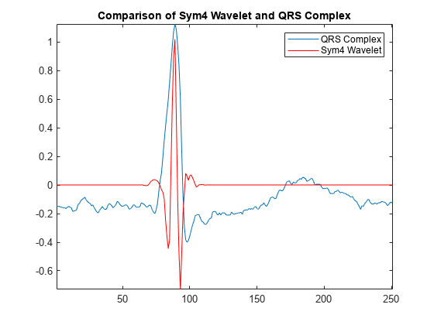
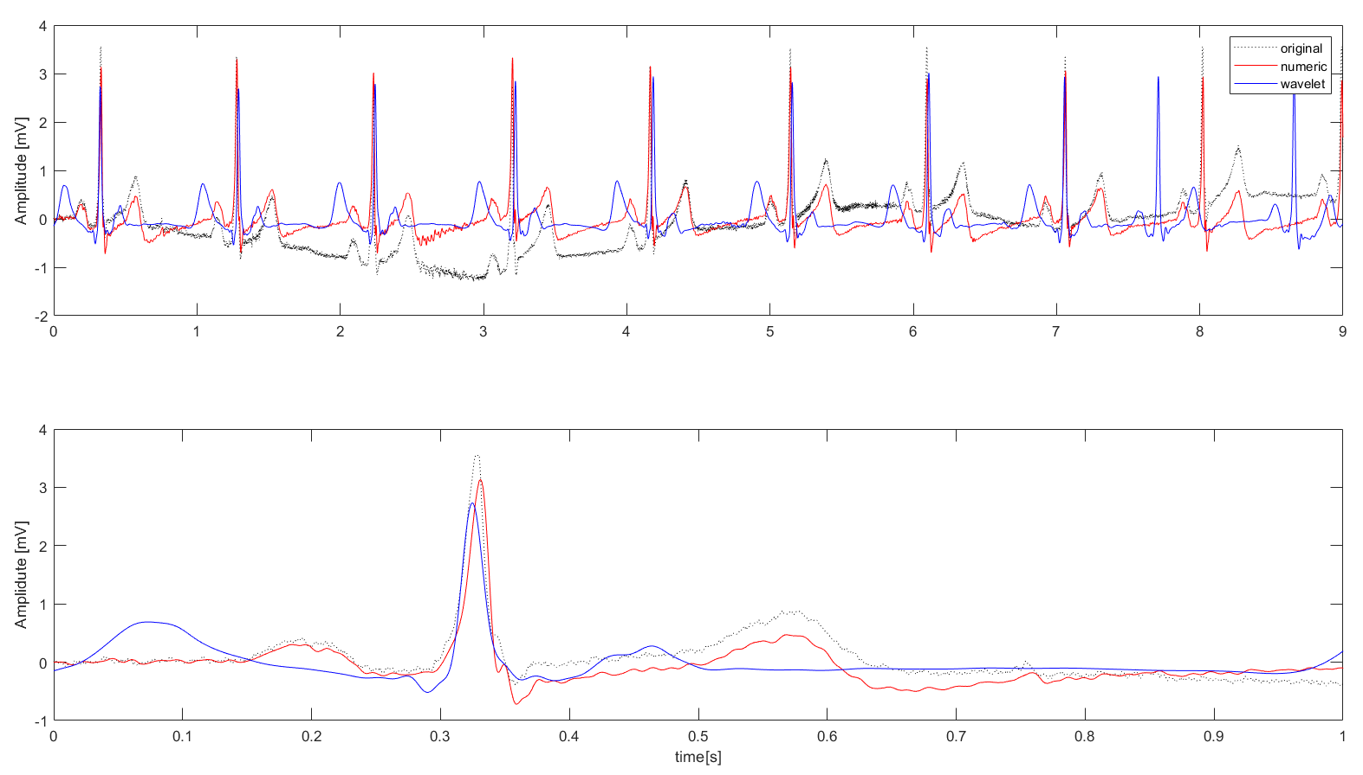
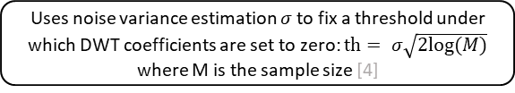
Filtering strategy
Here a combined filtering strategy is used: [2]
Wavelet Soft thresholding to reduce the effect of the high frequency noise [2,3,4]
Numerical (zero-phase) filters to remove the residual high frequency noise and remove the possible low-frequency drift [2]
Compared with a pure numerical filtering, this strategy improves the overall result.
Original signal
Symmetric padding
Improves the overall wavelet transformation [3]
DWT decomposition
Symlets 4 wavelet is used due to its good performances on ECG signals [2, 3]
Donoho soft thresholding
Uses noise variance estimation $σ$ to fix a threshold under which DWT coefficients are set to zero: $th= σ\sqrt{2log⁡(M)}$ where M is the sample size [4]
De-padding and DWT reconstruction
Butterworth HP filter (order 6, cutoff at 0.5 Hz)
Removes low frequency drift [2]
Butterworth LP filter (order 6, cutoff at 45 Hz)
Removes High frequency noise residuals [2]

Slide 11
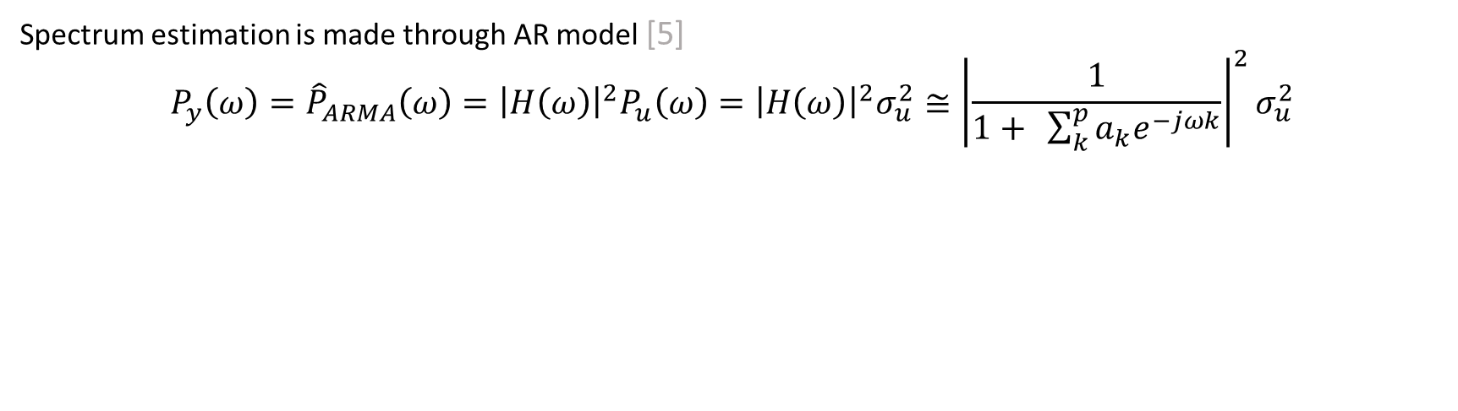
Spectrum estimation
Spectrum estimation is made through AR model [5]
$${P_{y}\left(ω\right)=\hat{P}}_{ARMA}\left(ω\right)={\left|H\left(ω\right)\right|}^{2}P_{u}\left(ω\right)={\left|H\left(ω\right)\right|}^{2}σ_{u}^{2}≅{\left|\frac{1}{1+ \sum_{k}^{p}{a_{k}e^{−jωk}}}\right|}^{2}σ_{u}^{2}$$
Spectrum of the target signal
Spectrum of ARMA model
Spectrum of the input signal of the model (white noise)
Transfer function of the AR model which approximates the ARMA one
ARMA models can be approximated by an AR with sufficiently high order
Fast and easy application
Require a zero-mean signal as input of the estimator of the model
Consistent and not windowed estimation of the spectrum
Order choice is crucial

Slide 12
Spectrum estimation: AR order choice
AR spectrum estimation is a well-established strategy but requires to fix the order of the model [5]
There are many strategies [6]:
AIC criterion
BIC criterion
AIC/BIC mixed strategy
Similarity between AR spectrum estimation and classical/Welch spectrogram
But there isn’t a “fixed” rule. In other studies, the optimal order is found to be between 8 and 20 [5,6] and all cases was fixed.
So far, AIC criterium has been used on a range of candidate orders, with a threshold to decide whether the order reached improves significantly the estimation.
Problems:
Leads to unnecessary high orders
Relies on the goodness of the threshold fixed by the user

Slide 13
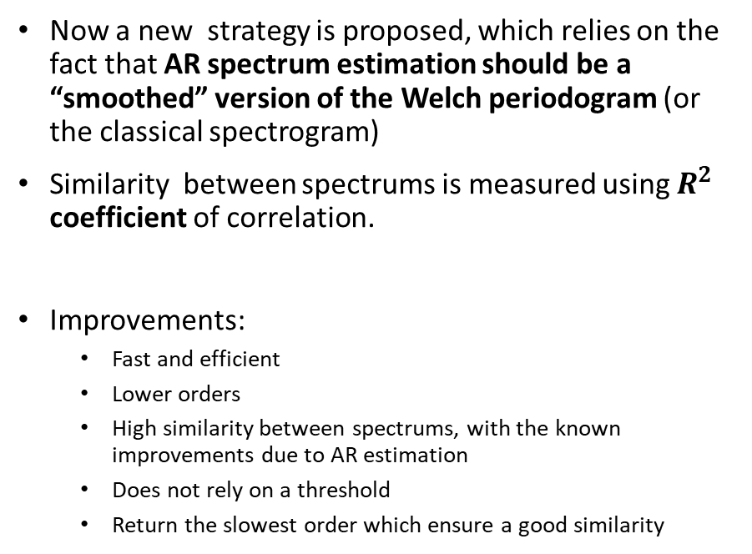
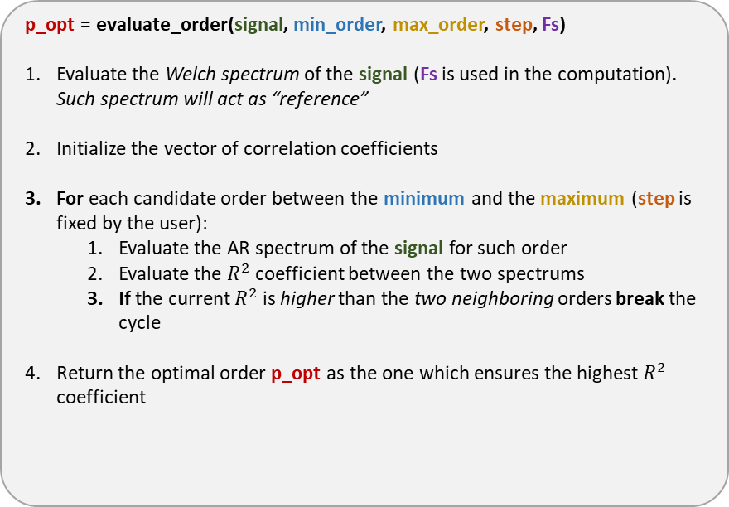
Spectrum estimation: AR order choice
Now a new strategy is proposed, which relies on the fact that AR spectrum estimation should be a “smoothed” version of the Welch periodogram (or the classical spectrogram)
Similarity between spectrums is measured using $R^{2}$ coefficient of correlation.
Improvements:
Fast and efficient
Lower orders
High similarity between spectrums, with the known improvements due to AR estimation
Does not rely on a threshold
Return the slowest order which ensure a good similarity
p_opt = evaluate_order(signal, min_order, max_order, step, Fs)
Evaluate the Welch spectrum of the signal (Fs is used in the computation). Such spectrum will act as “reference”
Initialize the vector of correlation coefficients
For each candidate order between the minimum and the maximum (step is fixed by the user):
Evaluate the AR spectrum of the signal for such order
Evaluate the $R^{2}$ coefficient between the two spectrums
If the current $R^{2}$ is higher than the two neighboring orders break the cycle
Return the optimal order p_opt as the one which ensures the highest $R^{2}$ coefficient

Slide 14
Outline
Correction of previous declarations about data
Why delve into spectral analysis
Expectations on EG spectrum
Processing pipeline to estimate spectrum
Filtering strategy
Spectrum estimation strategy
Results on external data
Conclusions

Slide 15
Spectrum estimation: AR order choice
Before applying the algorithm to the AVNRT data, it has been tested on external data:
Didactical ECG with High Frequency noise (Fc: 1000 Hz, ~ 8500 points)
Didactical ECG with Low Frequency noise (Fc: 1000 Hz, ~ 9000 points)
PhysioNet Database ECG data: healthy and pathological (Fc: 360 Hz, 9000 points)
For all these scenarios have been plotted the AR spectrums compared with the Welch spectrum and the Periodogram
The number of points onto evaluating the spectrums are increased to see the behaviour of the analysis when considering an increasing number of cardiac beats

Slide 16
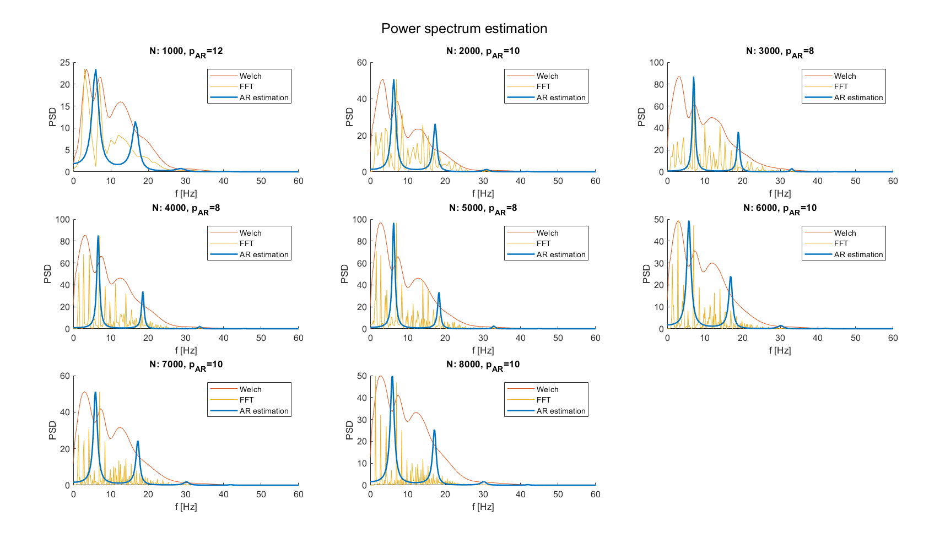
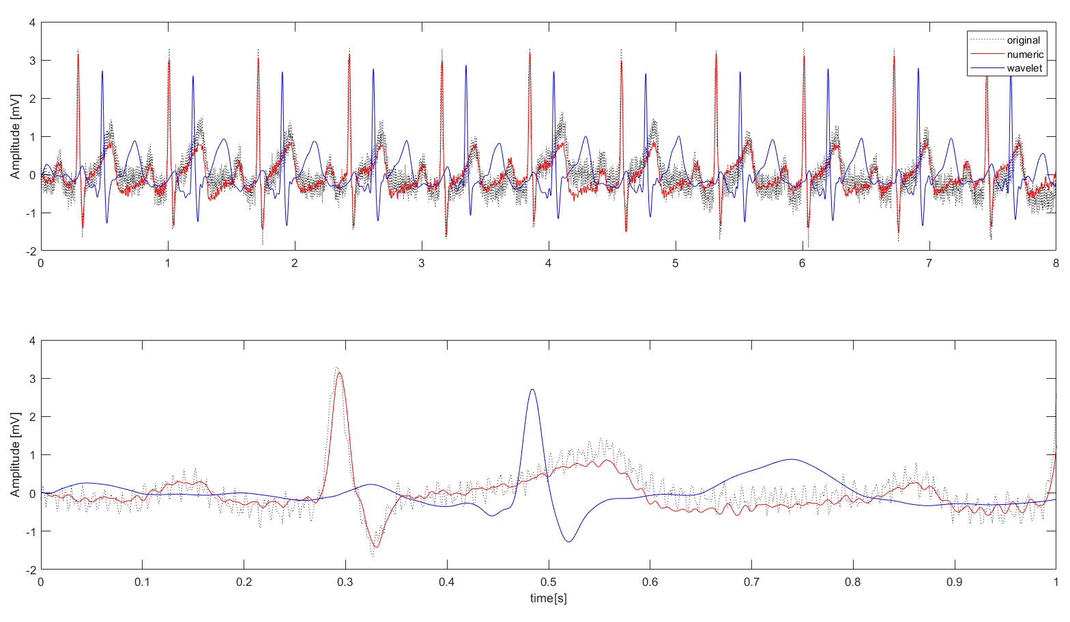
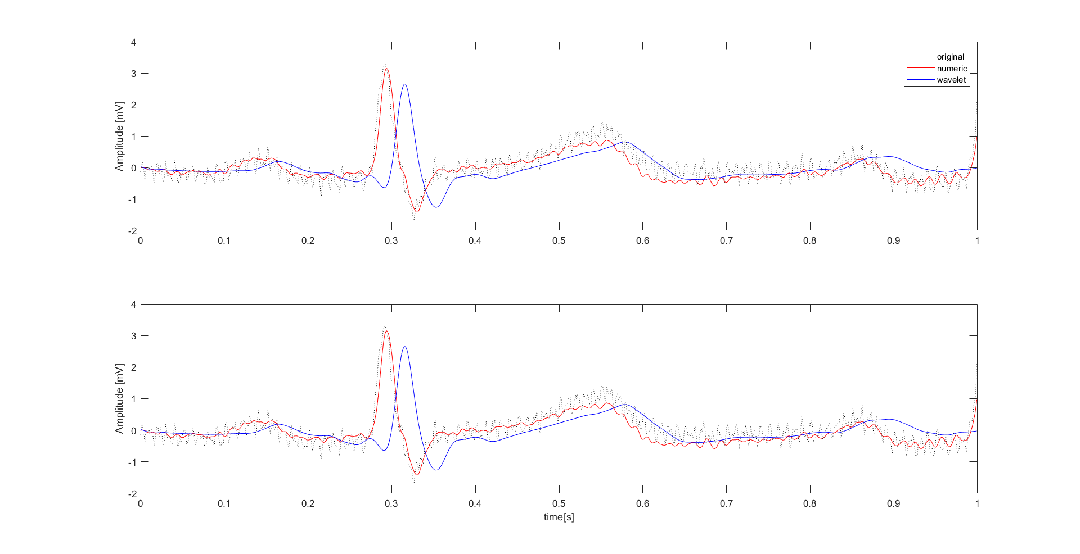
ECG with High Frequency Noise
Filtering Performance
Good reduction of noise and well-preserved ECG shape
Phase shift due to Padding (around 0.2 seconds)
Very limited if a single beat is considered
Spectrum evaluation performance
Good frequency resolution
Appreciable peaks when expected
Not considerable differences while augmenting the number of points

Slide 17

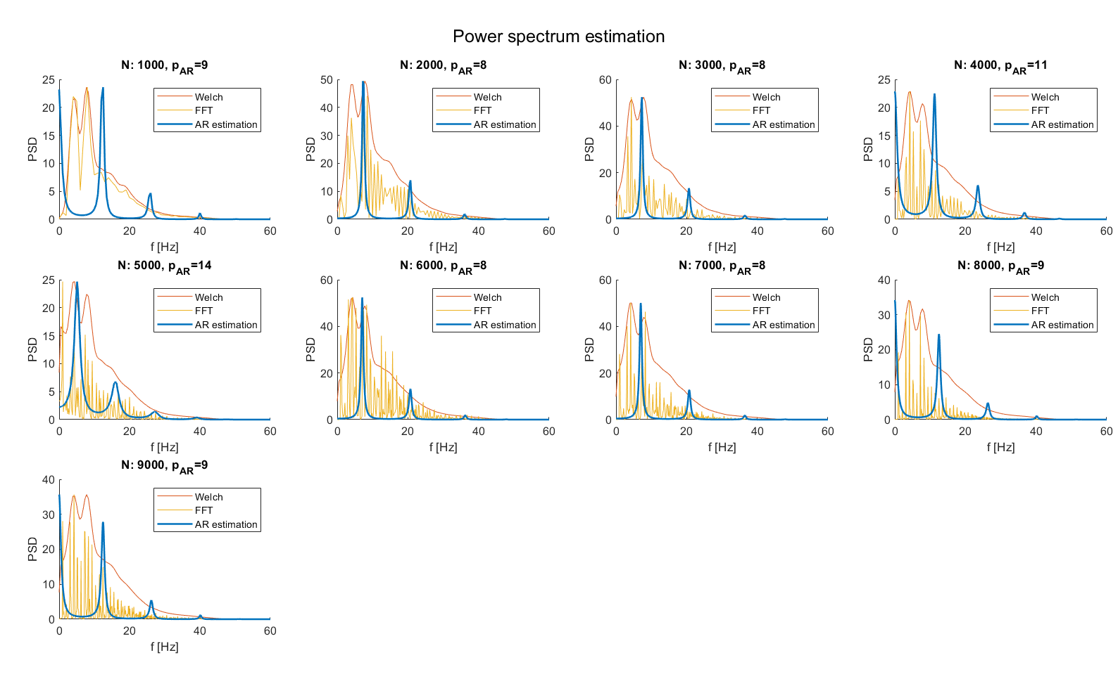
ECG with Low Frequency Noise
Filtering Performance
Good reduction of noise and well-preserved ECG shape
Phase shift due to DWT decomposition much less present
Spectrum evaluation performance
Good frequency resolution
Appreciable peaks when expected
Differences in peaks presences and amplitudes
When the order is odd, a peak (not acceptable) at 0 Hz appears.

Slide 18
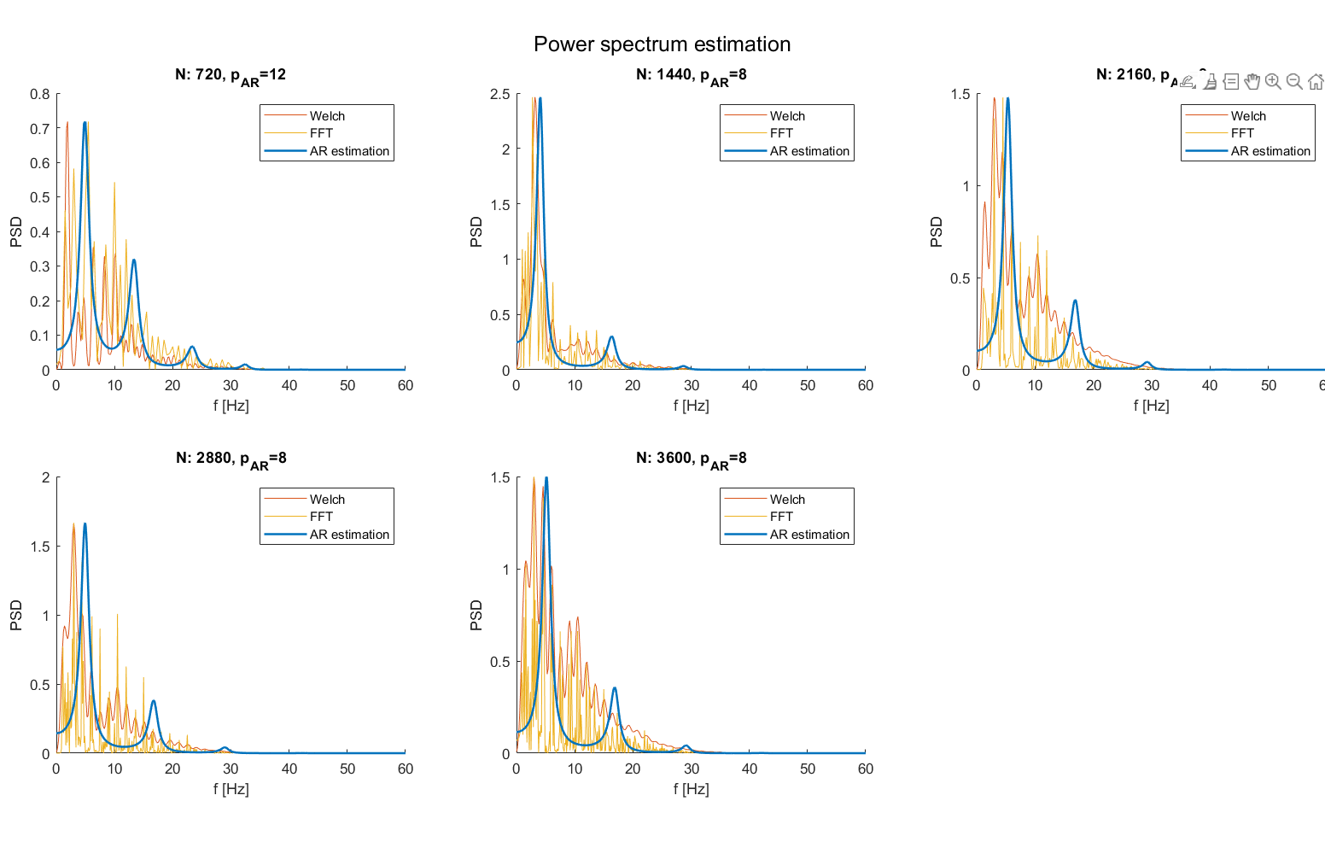
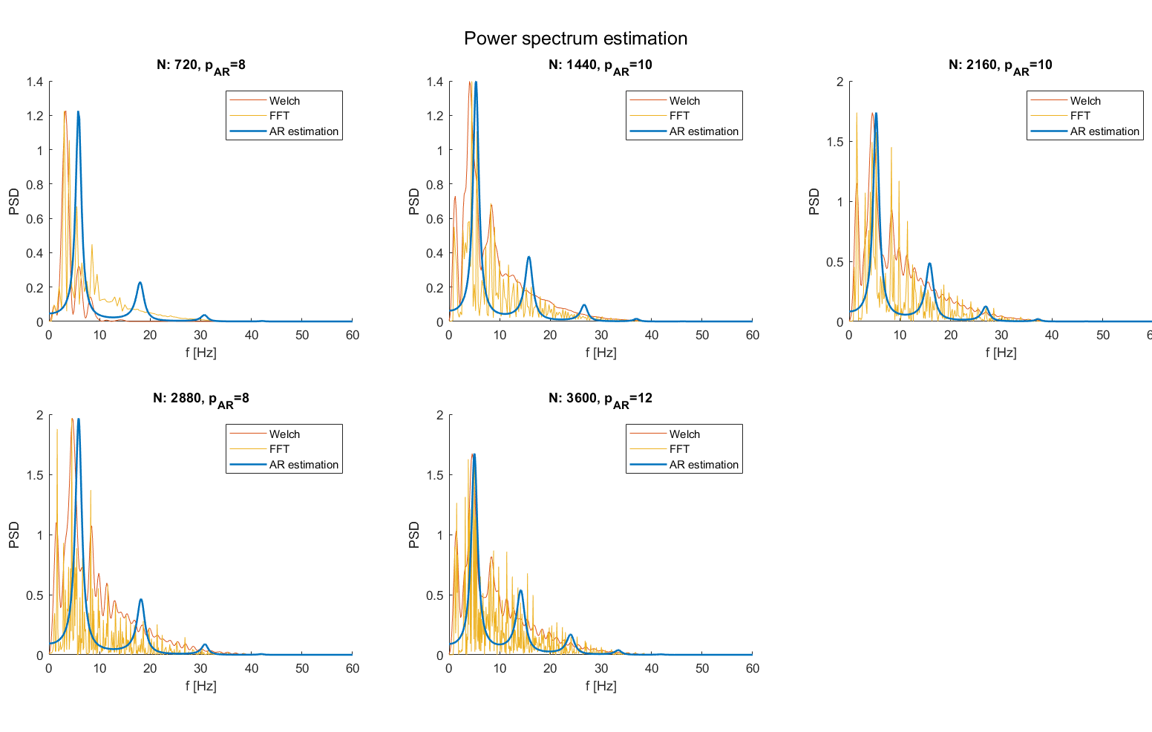
PhysioNet database
Healthy record
Good estimation of Welch spectrum even on “real world” data
Peaks presence limited between 0 and 30 Hz
Pathological Record
Good estimation of Welch spectrum
Presence of peaks above 30 Hz, an aspect that can be traced back to the pathology

Slide 19
Outline
Correction of previous declarations about data
Why delve into spectral analysis
Expectations on EG spectrum
Processing pipeline to estimate spectrum
Filtering strategy
Spectrum estimation strategy
Results on external data
Conclusions

Slide 20
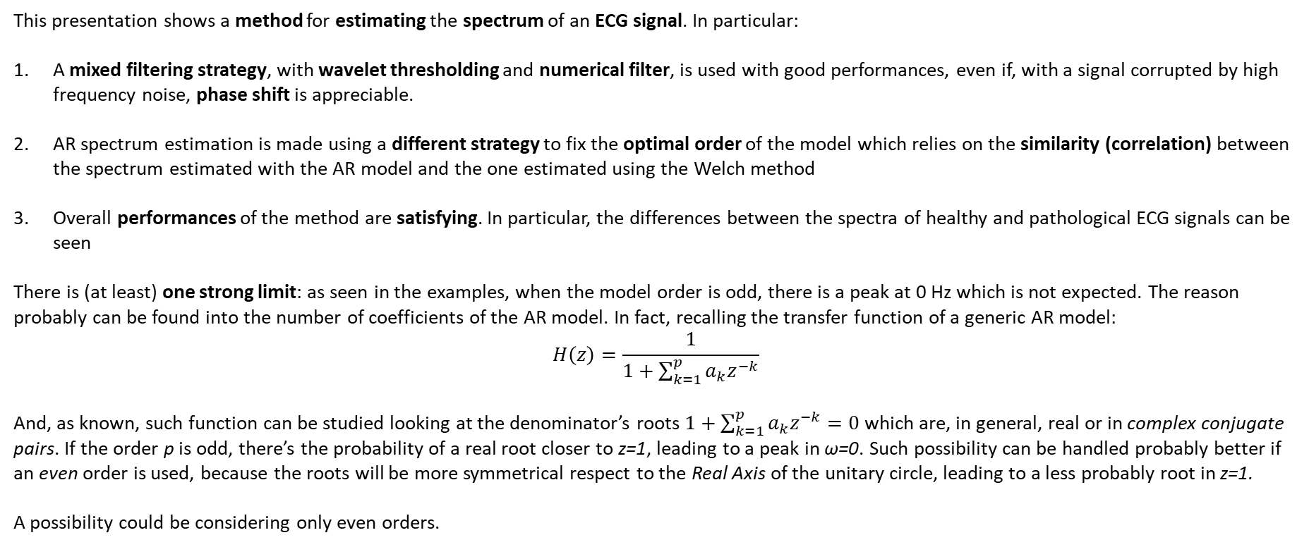
Conclusions
This presentation shows a method for estimating the spectrum of an ECG signal. In particular:
A mixed filtering strategy, with wavelet thresholding and numerical filter, is used with good performances, even if, with a signal corrupted by high frequency noise, phase shift is appreciable.
AR spectrum estimation is made using a different strategy to fix the optimal order of the model which relies on the similarity (correlation) between the spectrum estimated with the AR model and the one estimated using the Welch method
Overall performances of the method are satisfying. In particular, the differences between the spectra of healthy and pathological ECG signals can be seen
There is (at least) one strong limit: as seen in the examples, when the model order is odd, there is a peak at 0 Hz which is not expected. The reason probably can be found into the number of coefficients of the AR model. In fact, recalling the transfer function of a generic AR model:
$$H\left(z\right)=\frac{1}{1+\sum_{k=1}^{p}{a_{k}z^{−k}}}$$
And, as known, such function can be studied looking at the denominator’s roots $1+\sum_{k=1}^{p}{a_{k}z^{−k}}=0$ which are, in general, real or in complex conjugate pairs. If the order p is odd, there’s the probability of a real root closer to z=1, leading to a peak in ω=0. Such possibility can be handled probably better if an even order is used, because the roots will be more symmetrical respect to the Real Axis of the unitary circle, leading to a less probably root in z=1.
A possibility could be considering only even orders.

Slide 21
References
Sörnmo, Leif, and Pablo Laguna. "Electrocardiogram (ECG) signal processing." Wiley encyclopaedia of biomedical engineering (2006).
Saraiva, João & Plácido da Silva, Hugo & Fred, Ana. (2022). Denoising and Artifact Removal of the Electrocardiogram, Electrodermal Activity and Accelerometery for Continuous Ambulatory Monitoring of Epileptic Seizures with Wearable Devices. 10.13140/RG.2.2.10053.12004.
Singh, Brij N., and Arvind K. Tiwari. "Optimal selection of wavelet basis function applied to ECG signal denoising." Digital signal processing 16.3 (2006): 275-287.
Donoho, David L. "De-noising by soft-thresholding." IEEE transactions on information theory 41.3 (1995): 613-627.
Übeyli, Elif Derya, Dean Cvetkovic, and Irena Cosic. "AR spectral analysis technique for human PPG, ECG and EEG signals." Journal of Medical Systems 32 (2008): 201-206.
Nayak, Jagadish, et al. "AR modeling of heart rate signals." 2004 IEEE Region 10 Conference TENCON 2004.. IEEE, 2004.

Slide 22
MIT-BIH arrythmia database
General Characteristics:
Number of patients: Contains recordings from 47 patients (48 half-hour records, leading to 24h of ECG signal).
Origin: Collected at MIT with the BIH arrythmia laboratories.
Year: Originally published in 1980, with subsequent updates and revisions.
Data Format (for each record)
.dat: raw data in binary format (11-bit per sample) from different leads, sampled at 360 Hz,
.hea: header of the corresponding .dat file containing information about sampling frequency, leads recorded, calibration, patient…
.atr: manual annotations about the pathologies
.qrs, .xws: other information about QRS complex position and waveform data
This database is widely used in research for developing and testing arrhythmia detection algorithms.
Original folder
Data extraction pipeline
For each record
Calibration
Leads
Sampling frequency
.dat from lead1 correctly converted from binary format
Header decoding
Saving into a Matlab struct
Note: annotations about single episodes of arrythmia were not saved because not necessary to proceed with the analysis, the crucial point is that these ECG records present a certain pathology

Slide 23
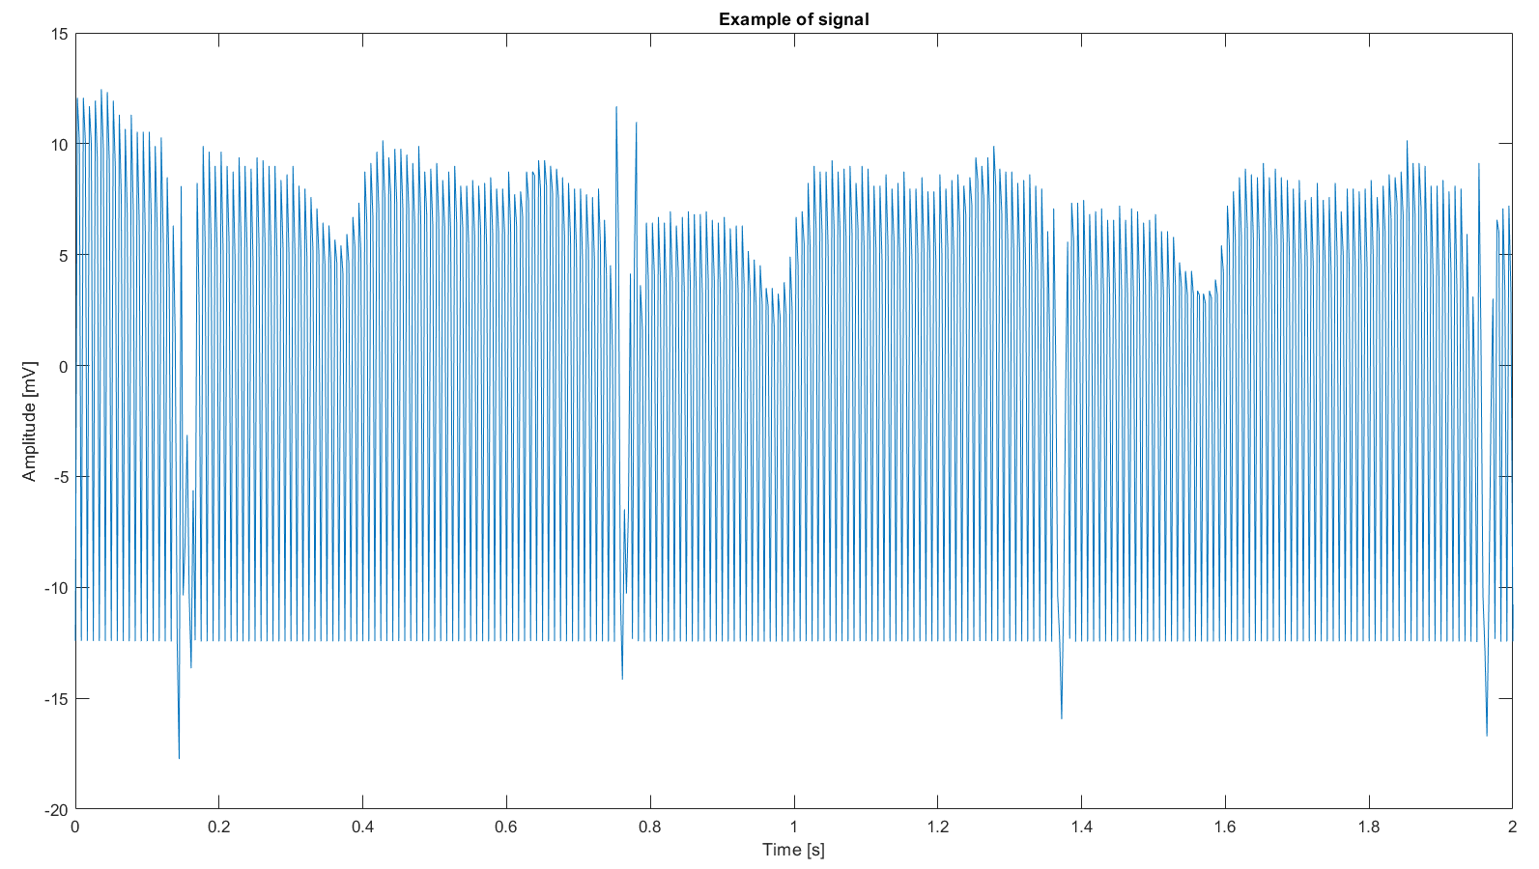
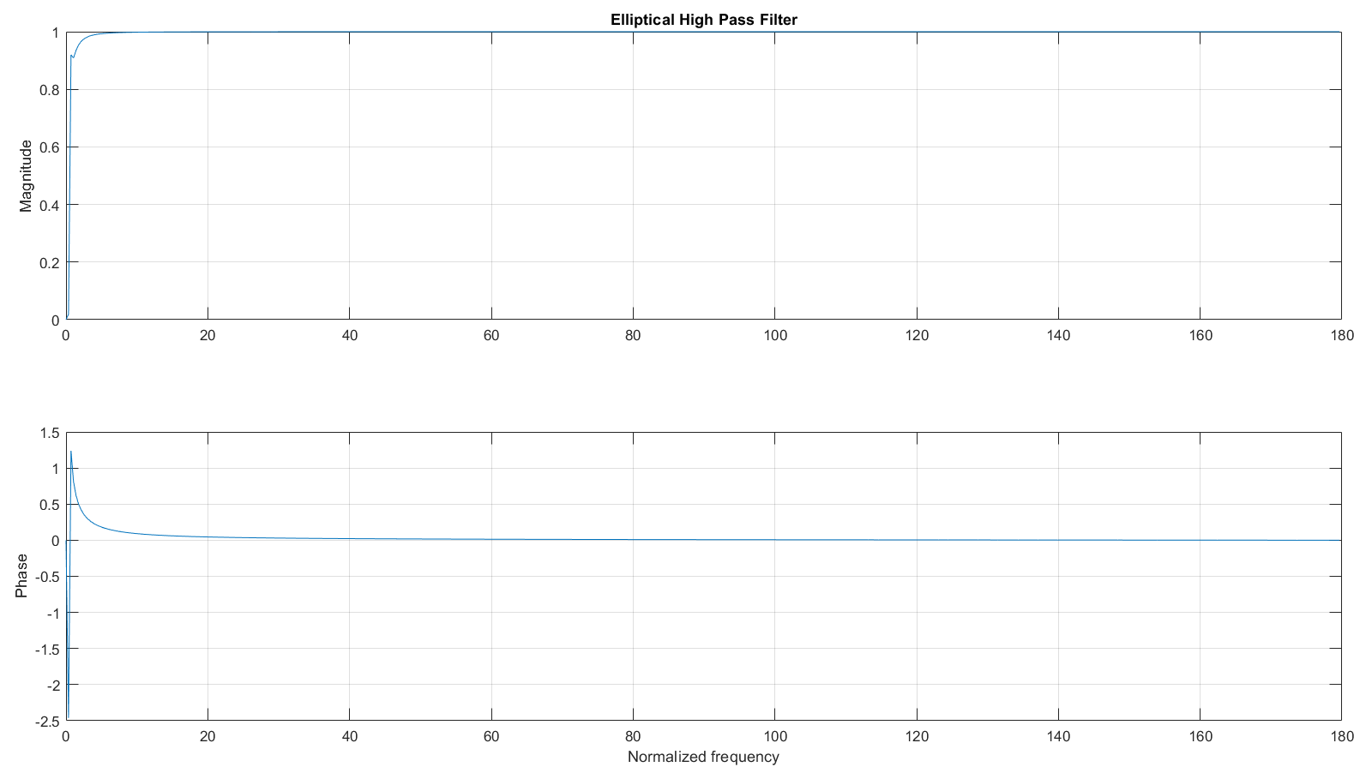
MIT-BIH arrythmia DB: preprocessing
First look on data:
Data present clearly high frequency noise. Probably these data should be filtered before proceeding with other evaluations.
In our case, as we would like to investigate the behavior at high frequency, cleaning the signal clearly leads to an error
Data preprocessing pipeline:
Drift removing with High Pass filter
Mean removing
Record subdivision to augment the total number of signals:
For each patient: 100 randomly selected signals of 10 seconds of duration
Leading to 4800 signals
These sub-signals were used for each subject to evaluate the spectrum
Signal example
Elliptical HP filter
Subdivision

Slide 24
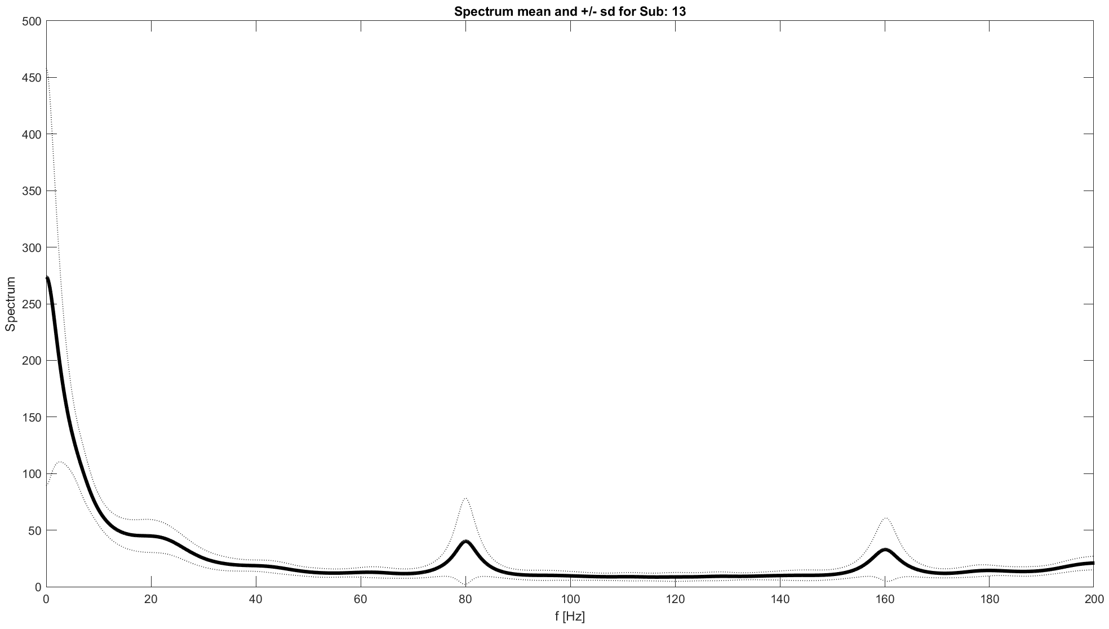
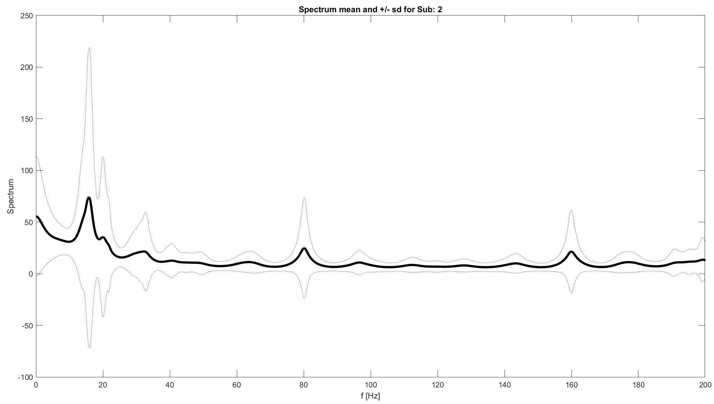
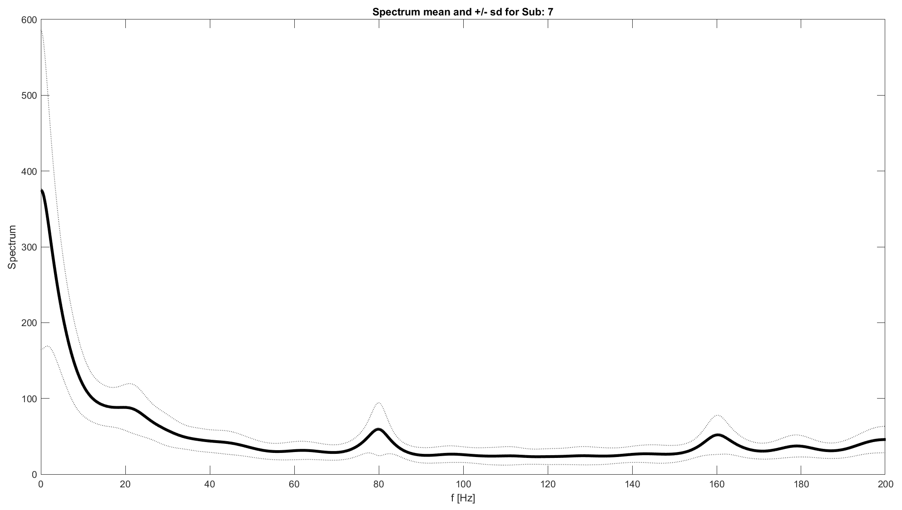
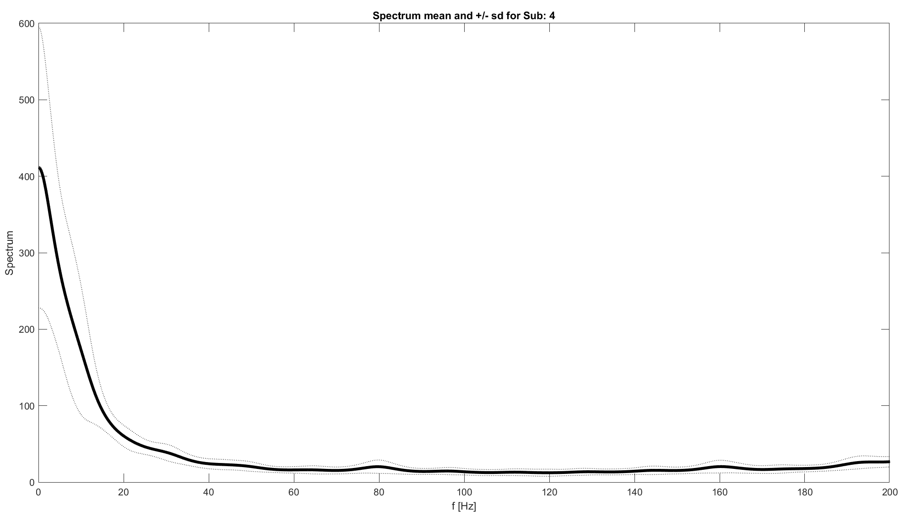
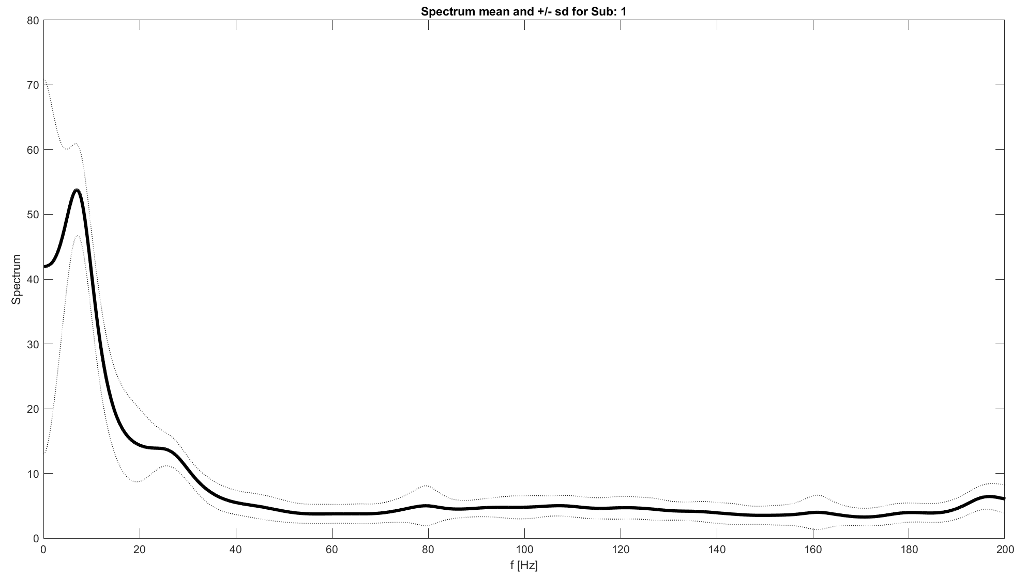
MIT-BIH arrythmia DB: spectrums
Spectrums were evaluated using the AR estimation as done previously. Then, mean ± SD spectrum were plotted.
In some traces there are appreciable peaks at high frequency, conducible to noise
No trace have sparse high frequency components, while low frequency ones are very well represented
Clearly, there are some differences between subjects
If there are difference between pathologies, these not seems to be represented into high frequencies

Slide 25
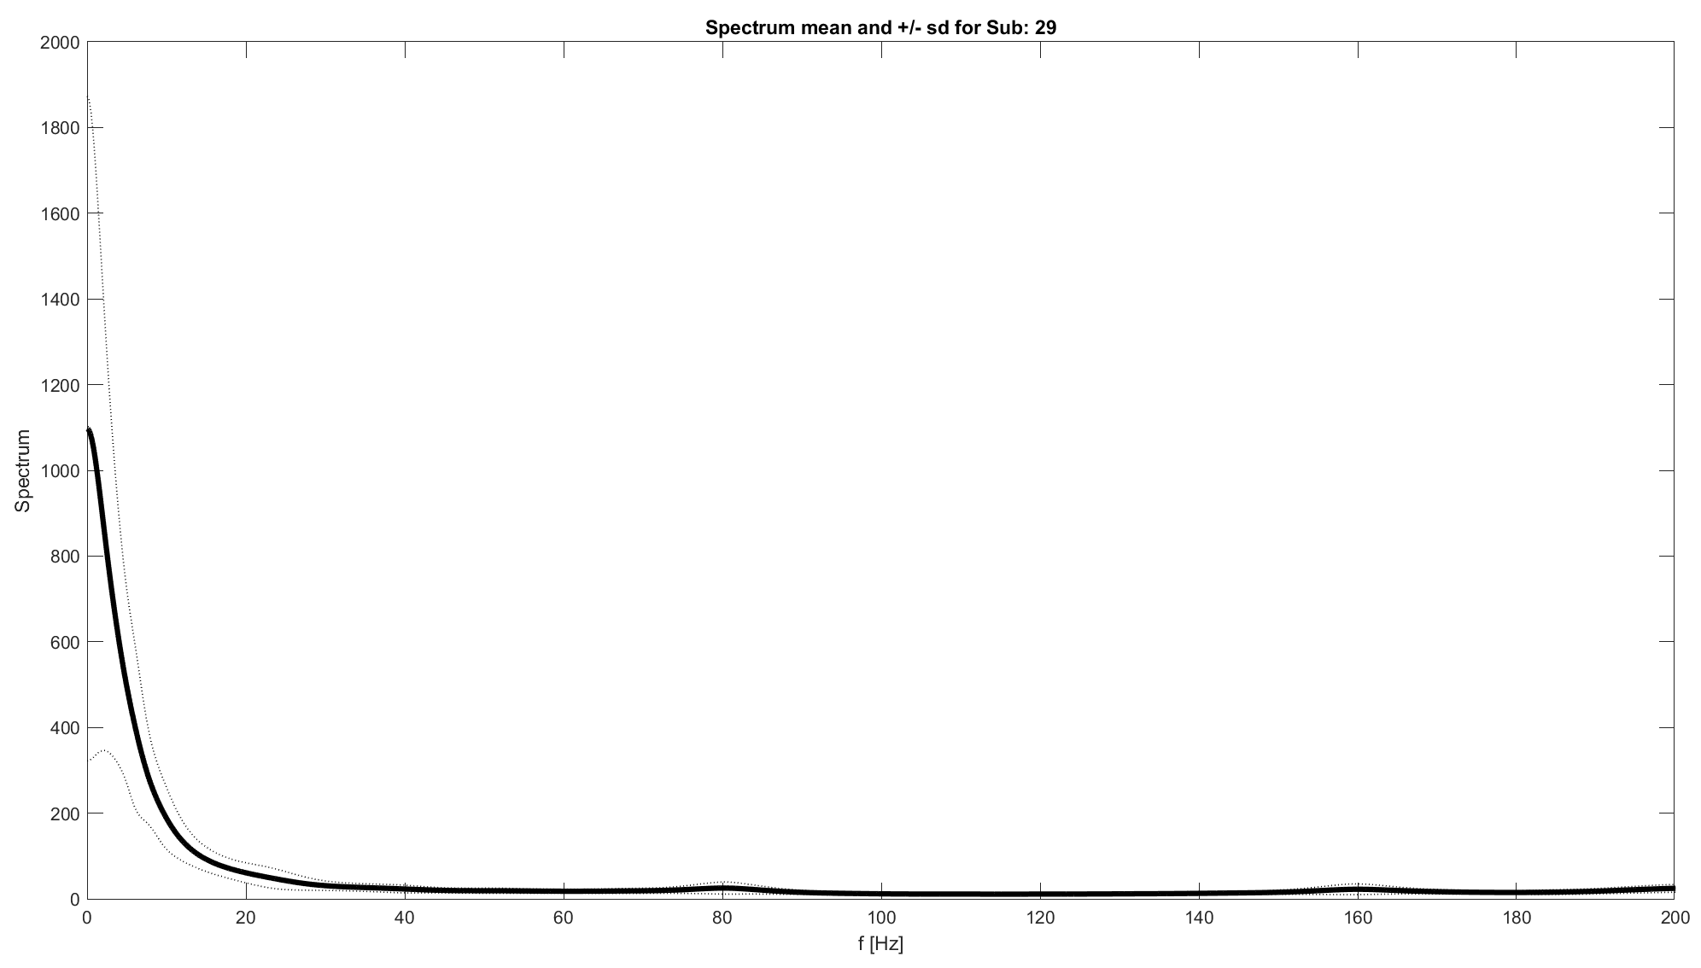
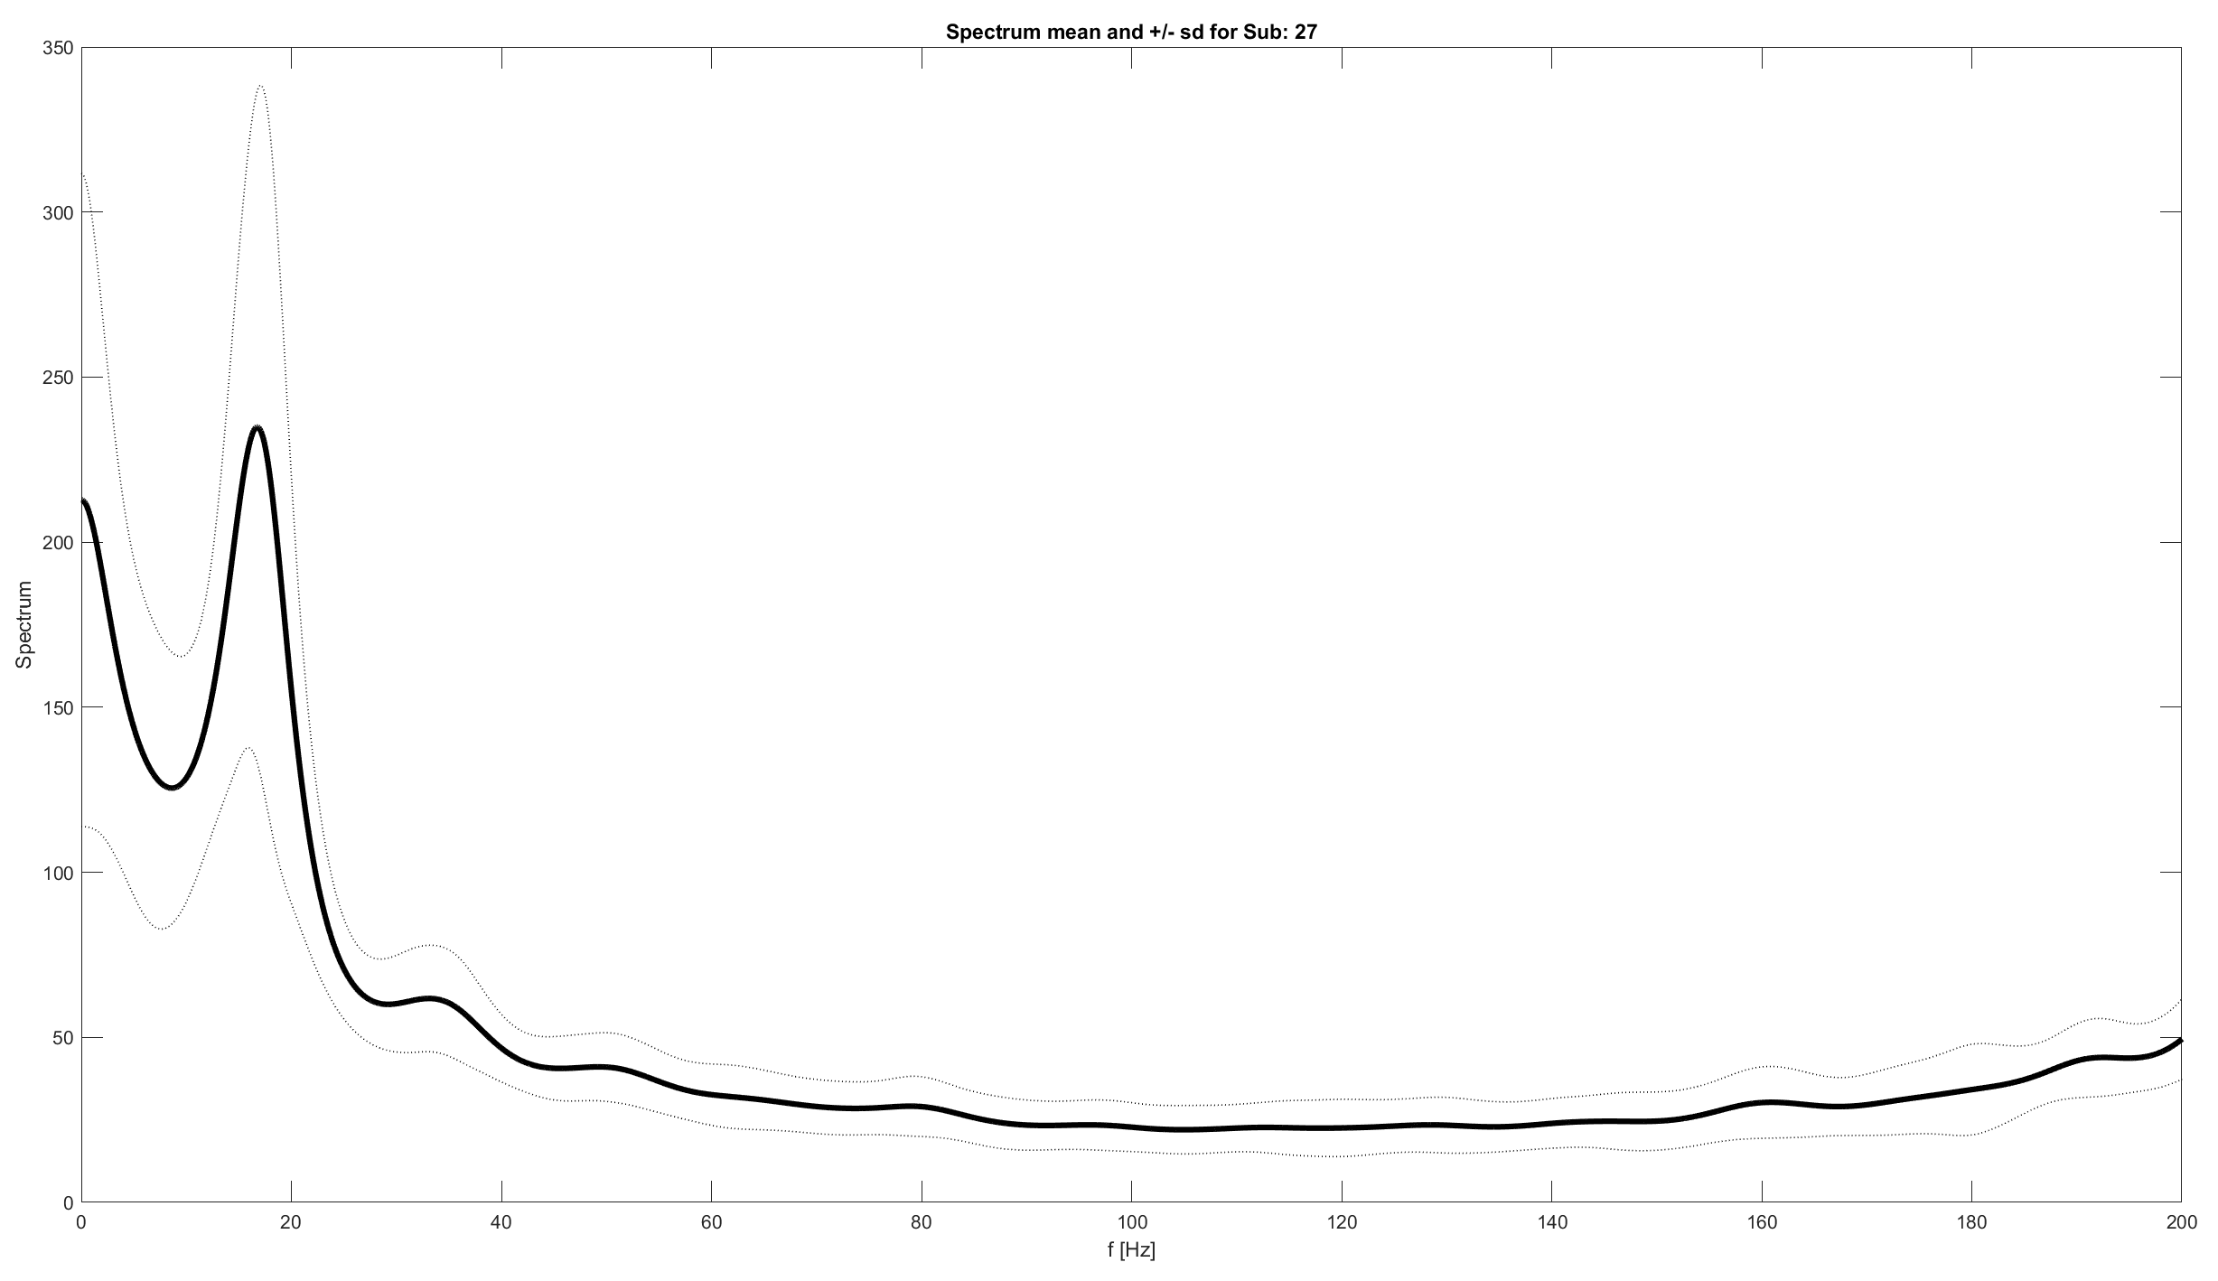
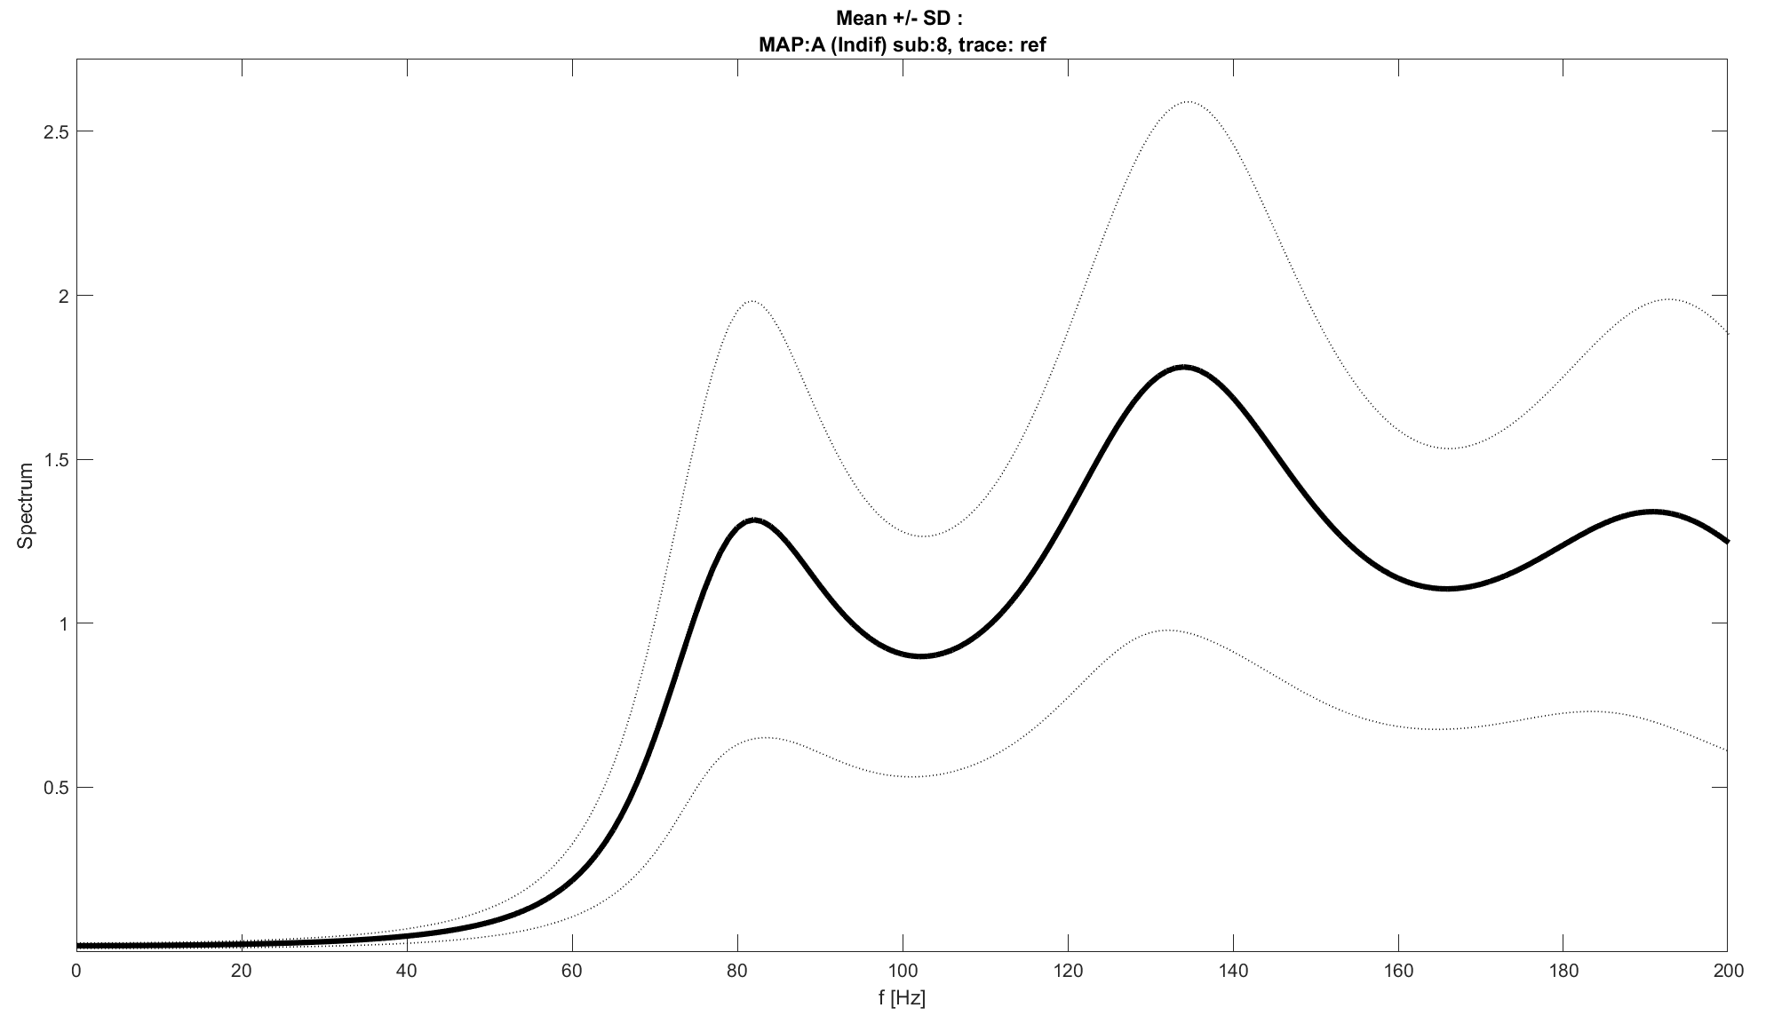
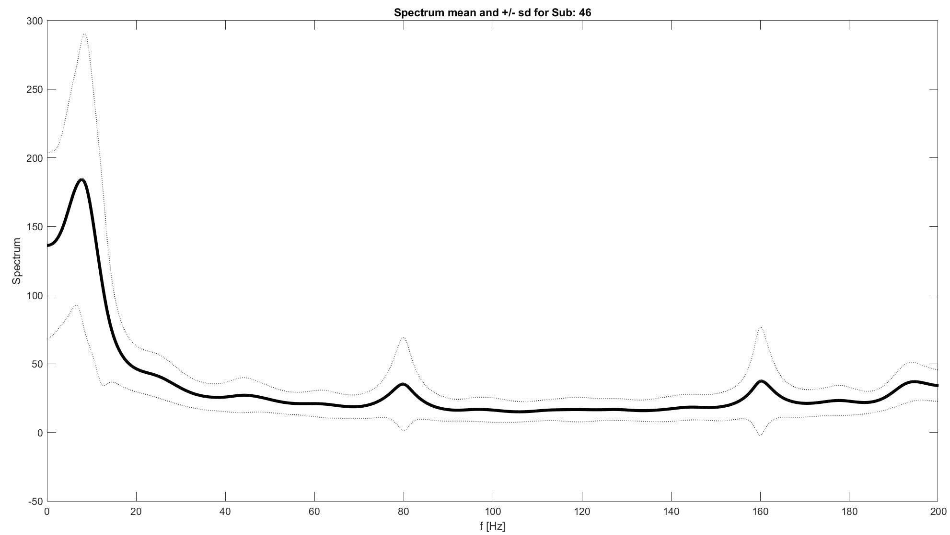
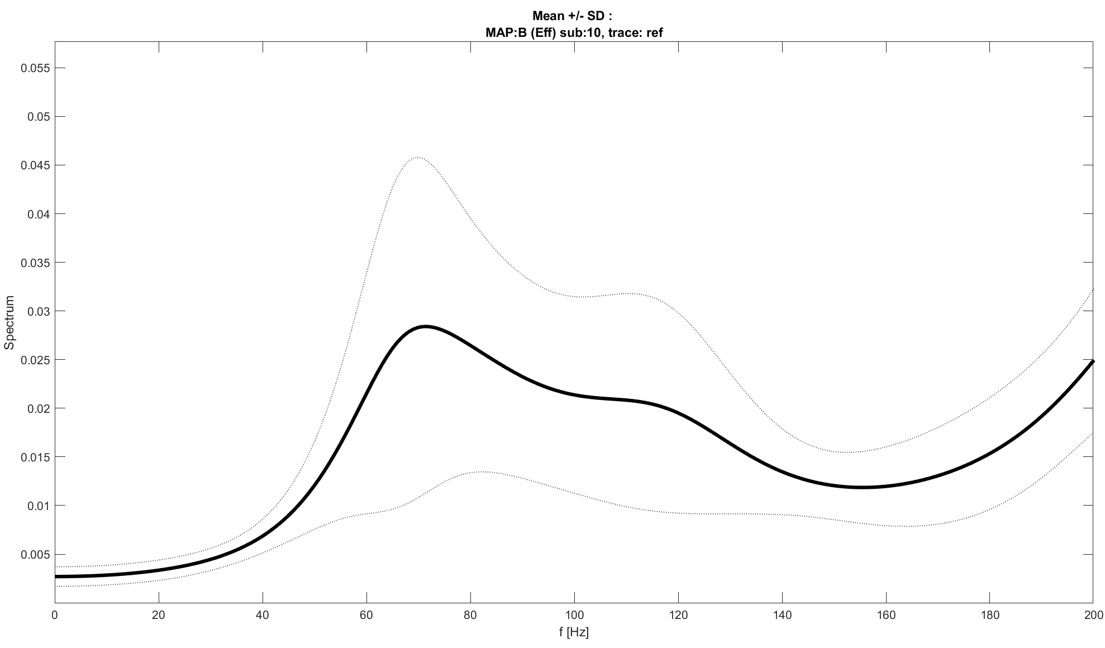
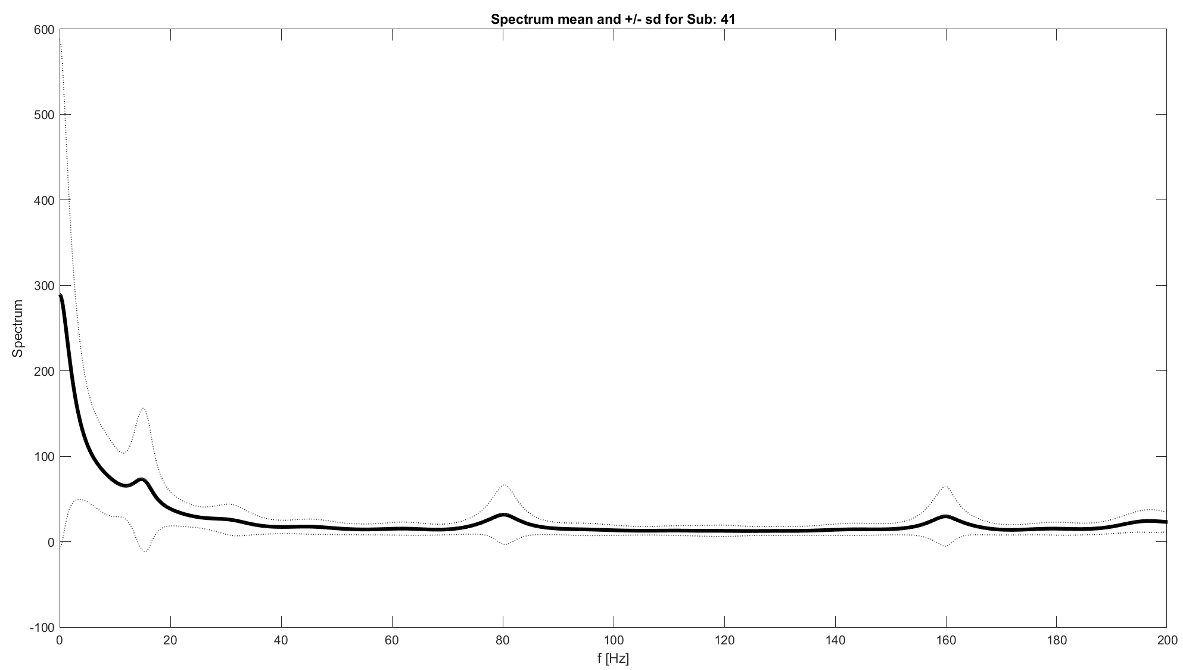
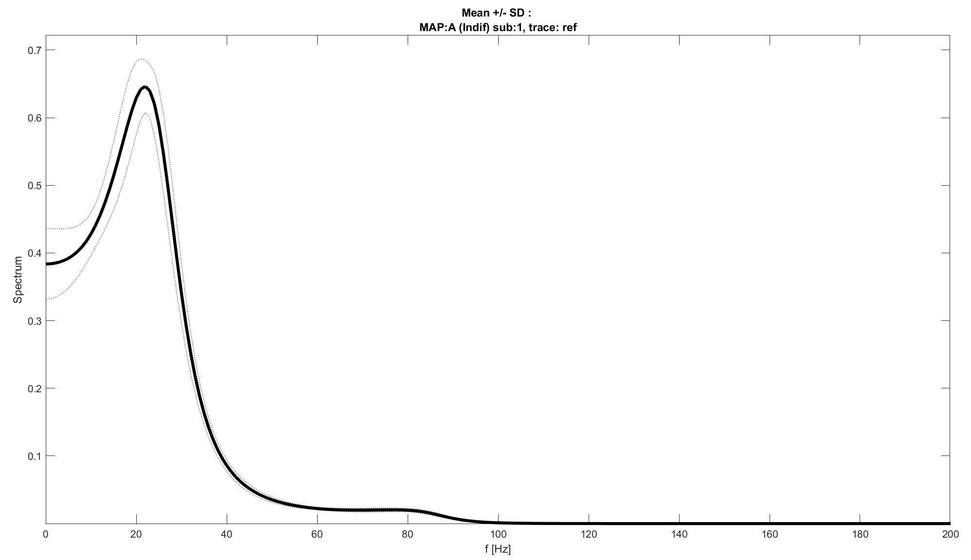
Spectrum comparison
MIT-BIH spectrums
Clear distribution of spectrum shape
peaks at high frequency, conducible to noise
No sparse high frequency components, dominant presence of low frequency ones
AVNRT reference trace spectrums
Unclear distribution of spectrum shapes
Absence of appreciable noise
Presence of spectrums with sparse high frequency components

Slide 26
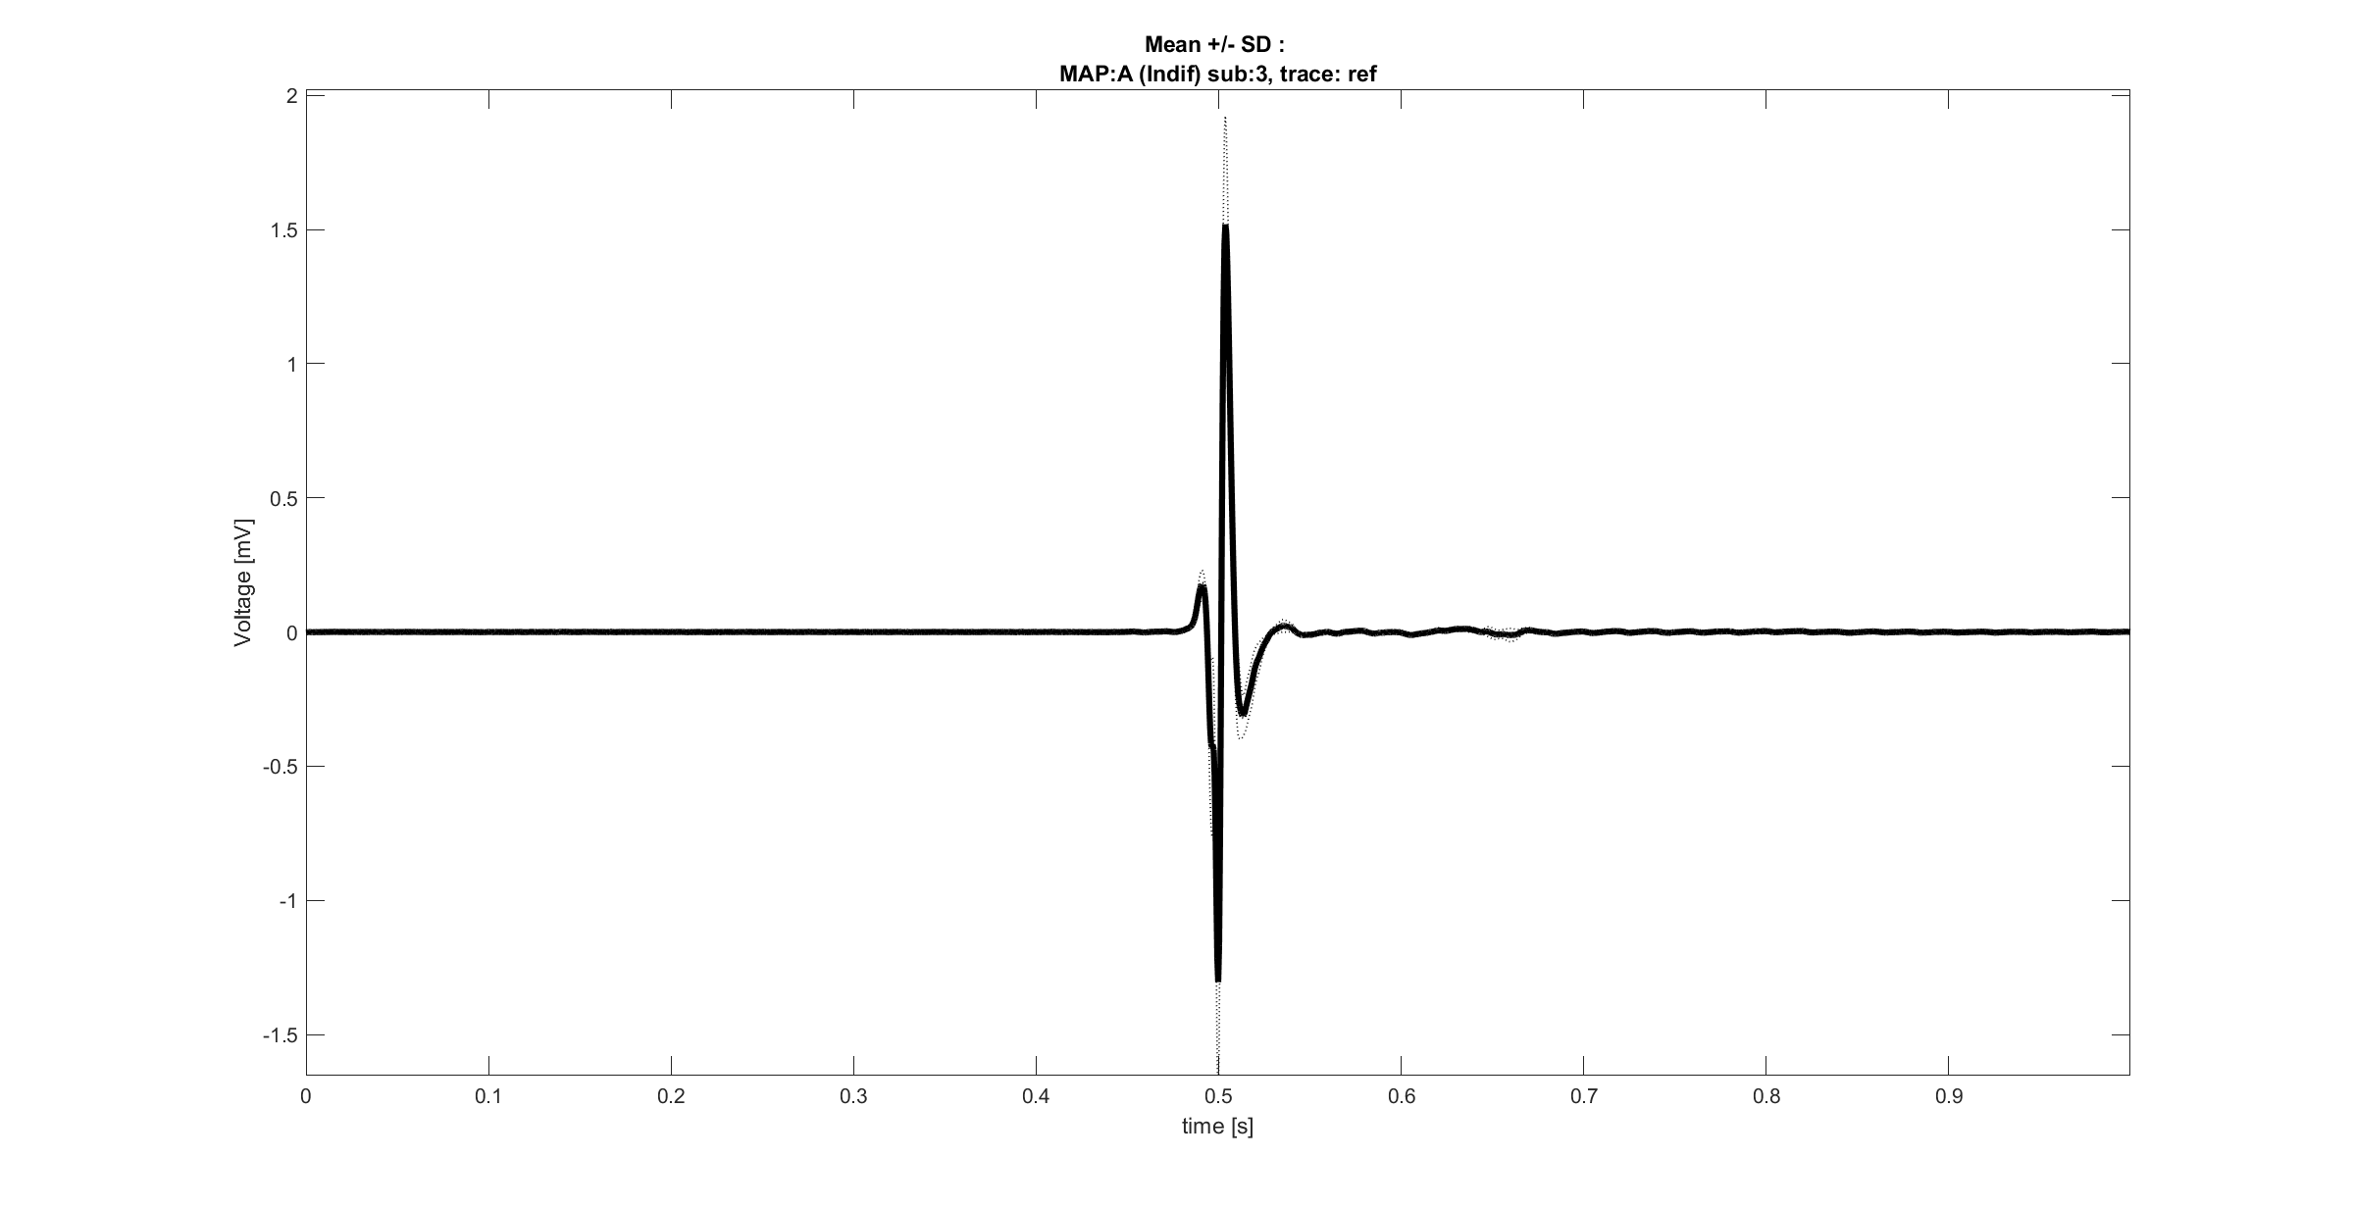
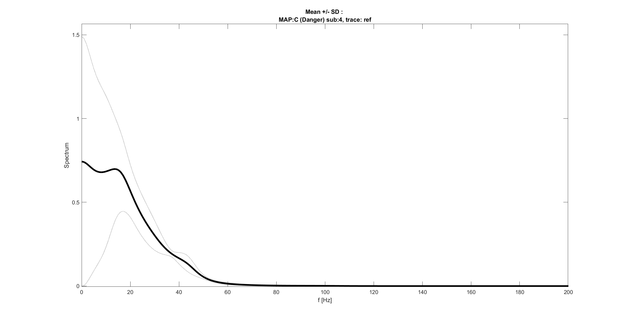
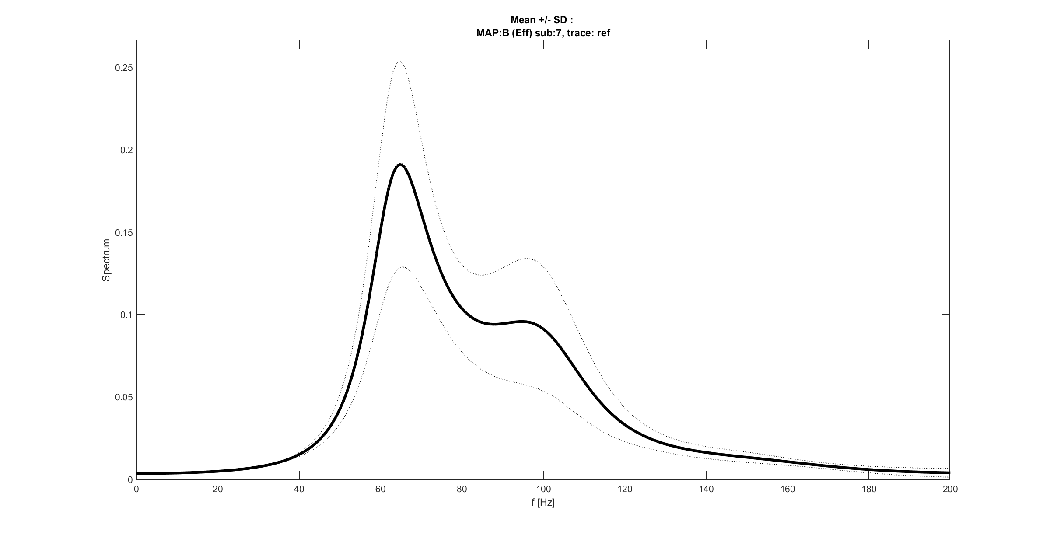
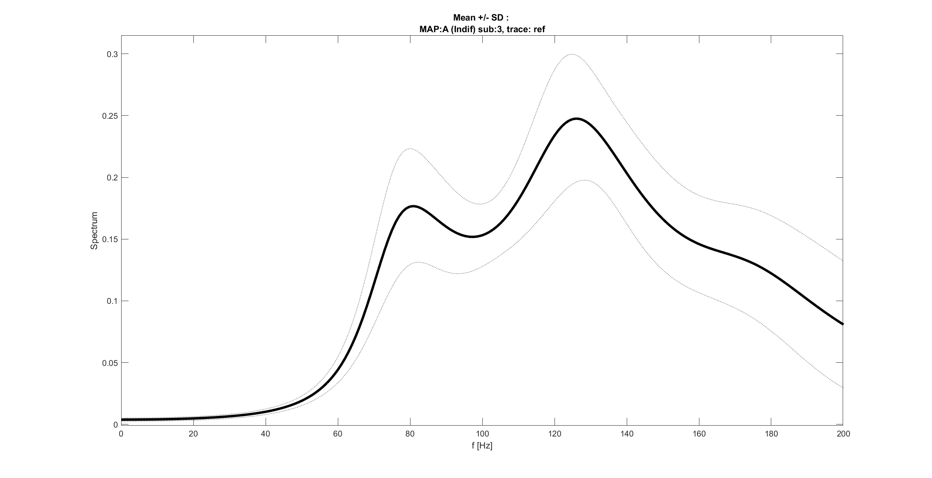
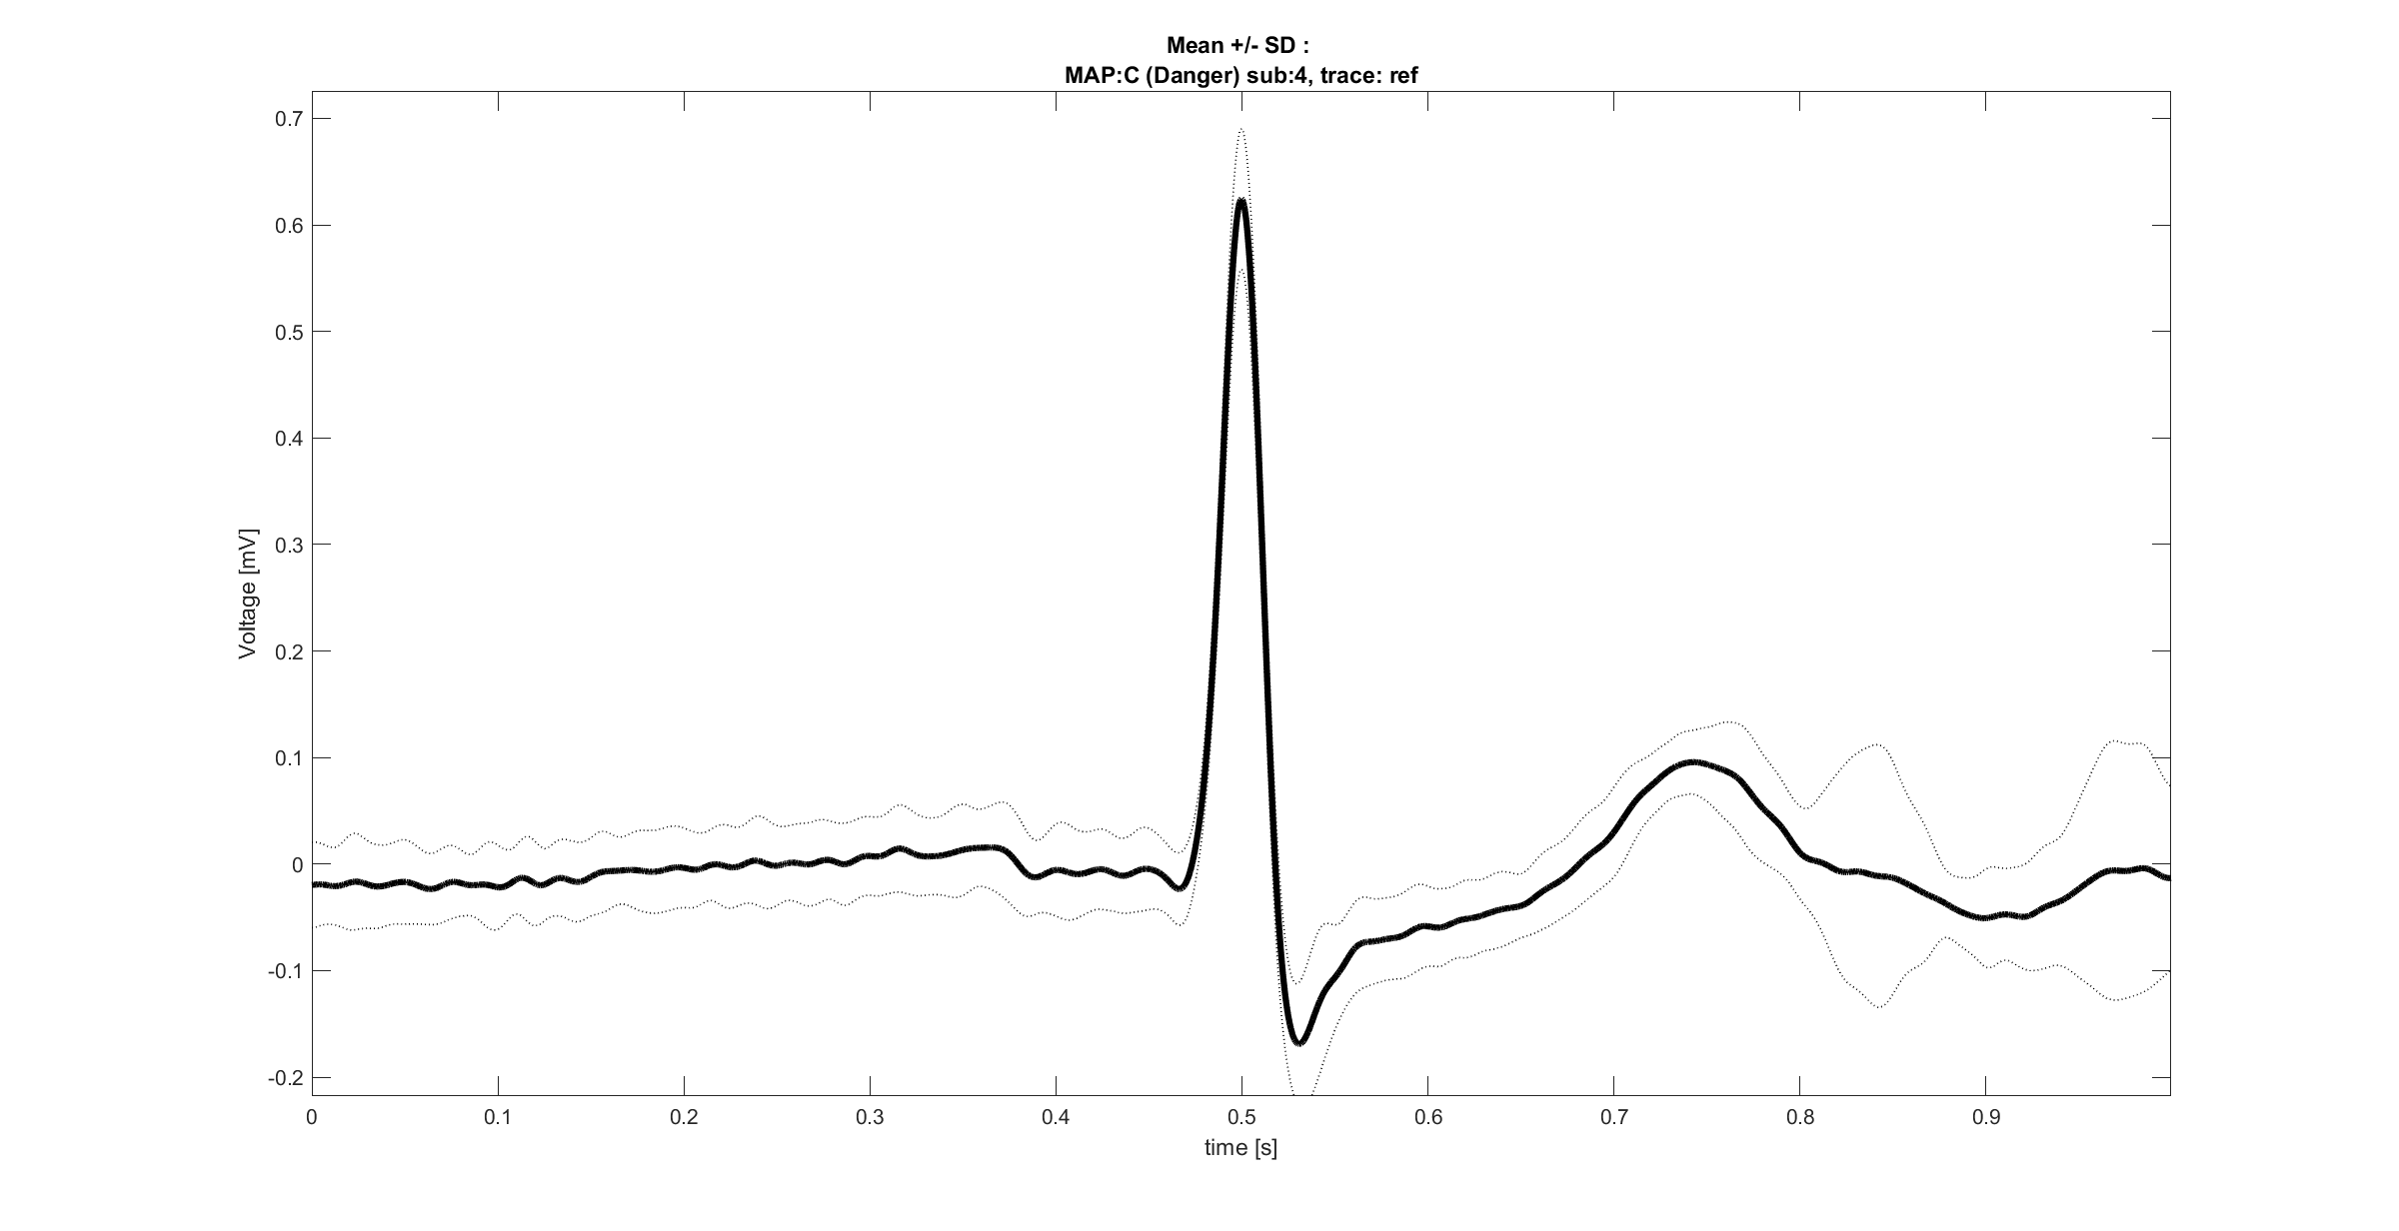

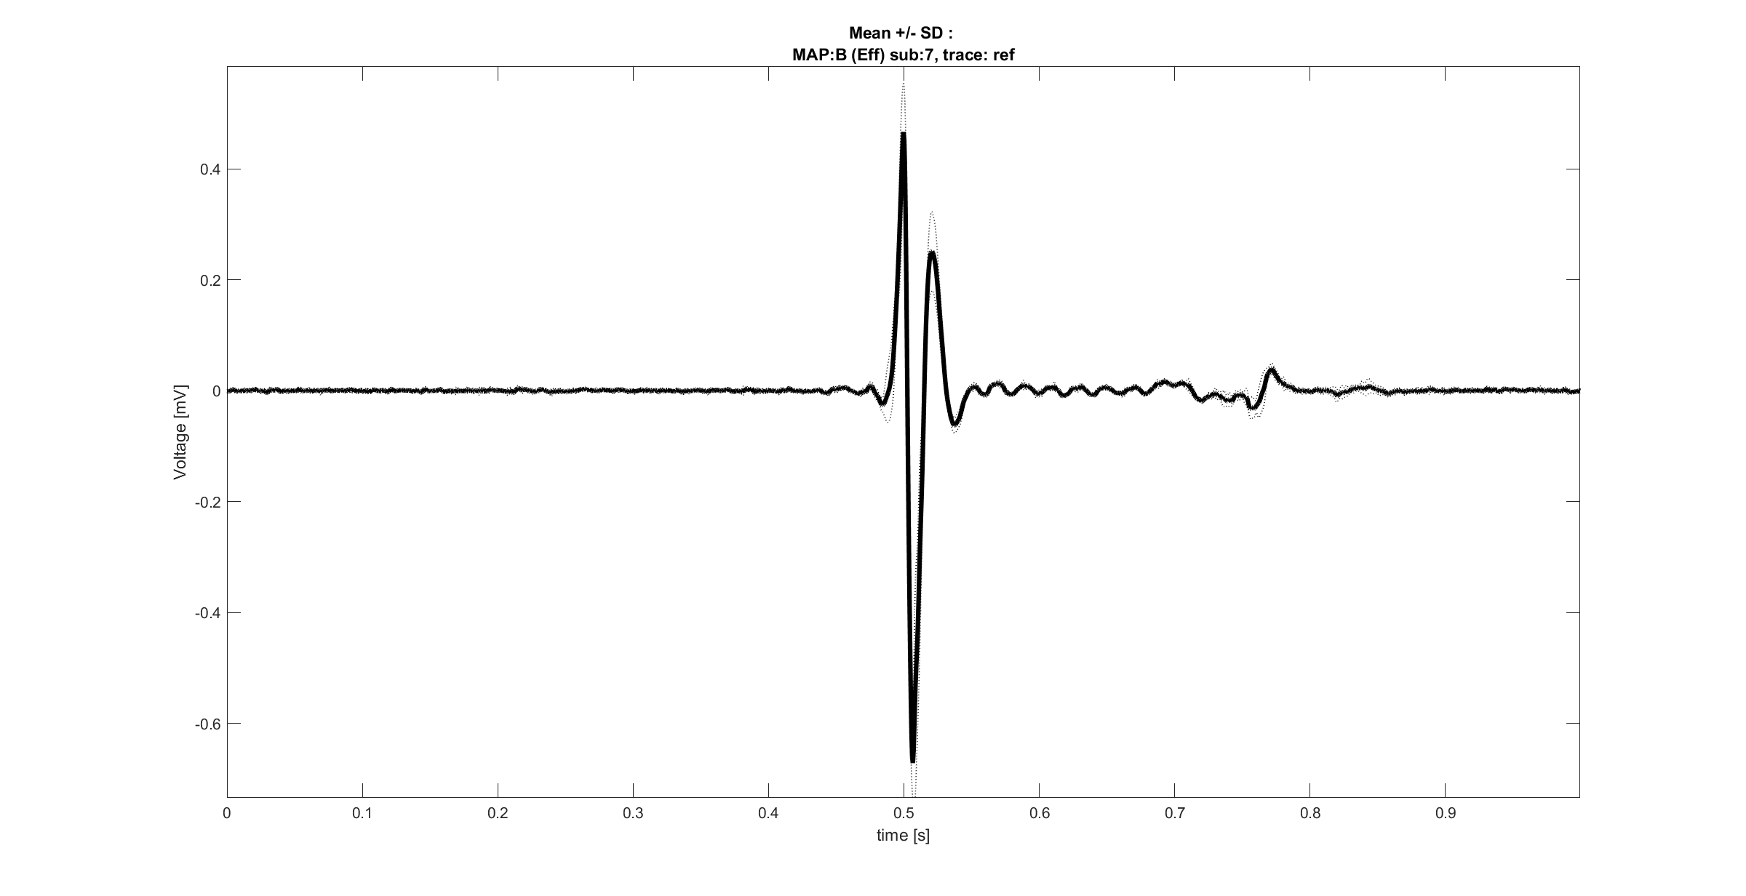
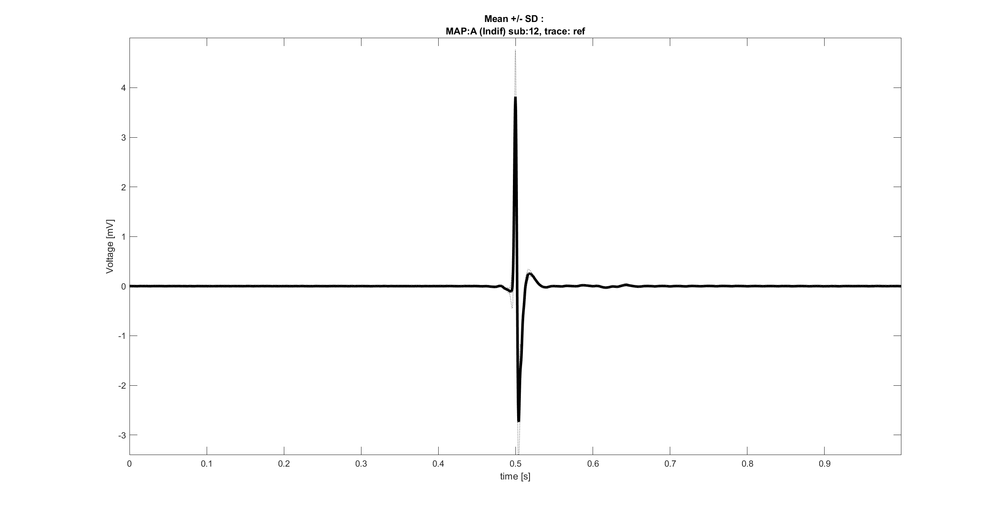
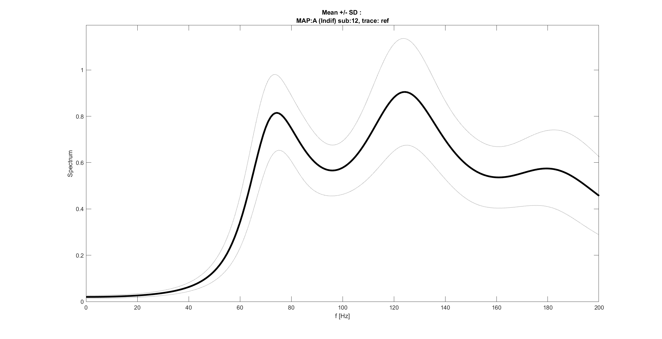
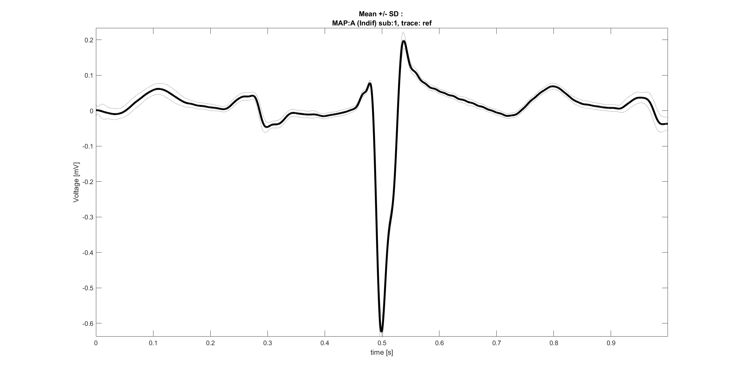
AVNRT spectrums: going deeper
Seems that differences between spectrums should be found into the intrinsic characteristics of signals, instead of the pathology.
Which are the differences between reference traces that can justify such behavior?
Time domain
FFT domain
Looking at these examples, seems that a spectrum with high frequency components is associated with a signal with an amplitude of the QRS much higher than other waves, particularly the P one.
Such consideration suggest the possibility of masking between components.

